Slide 1
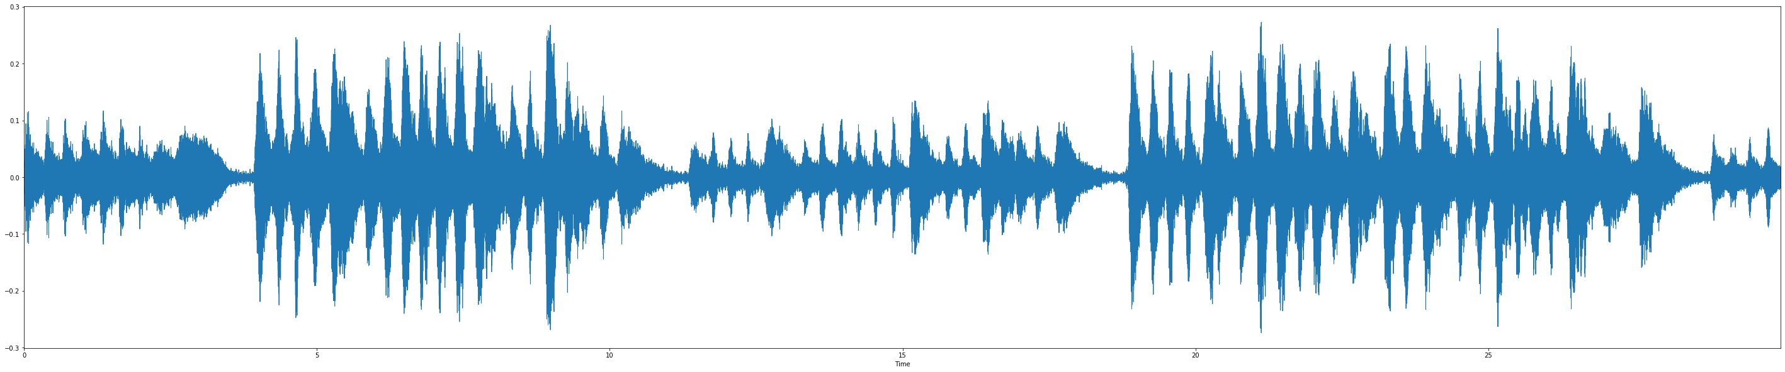

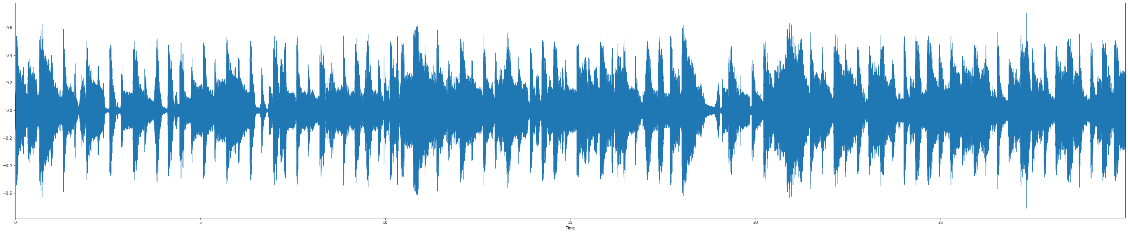
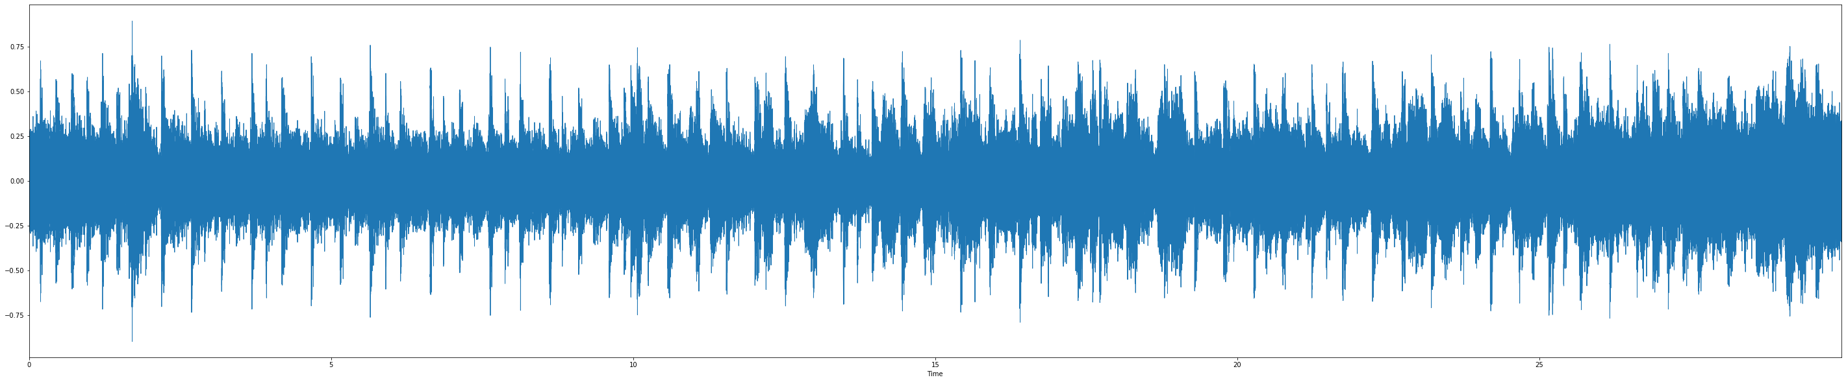
Género musical: classical
Canción: classical.00098.wav
Género musical: pop
Canción: pop.00032.wav
Género musical: metal
Canción: metal.00082.wav

Slide 2
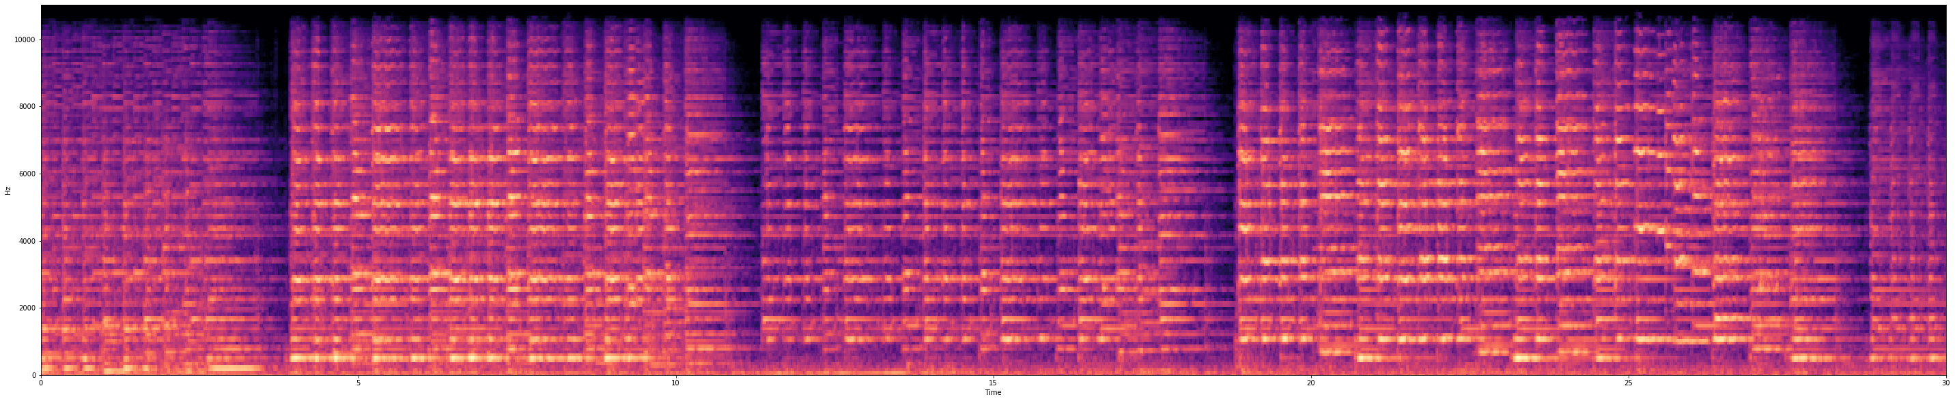
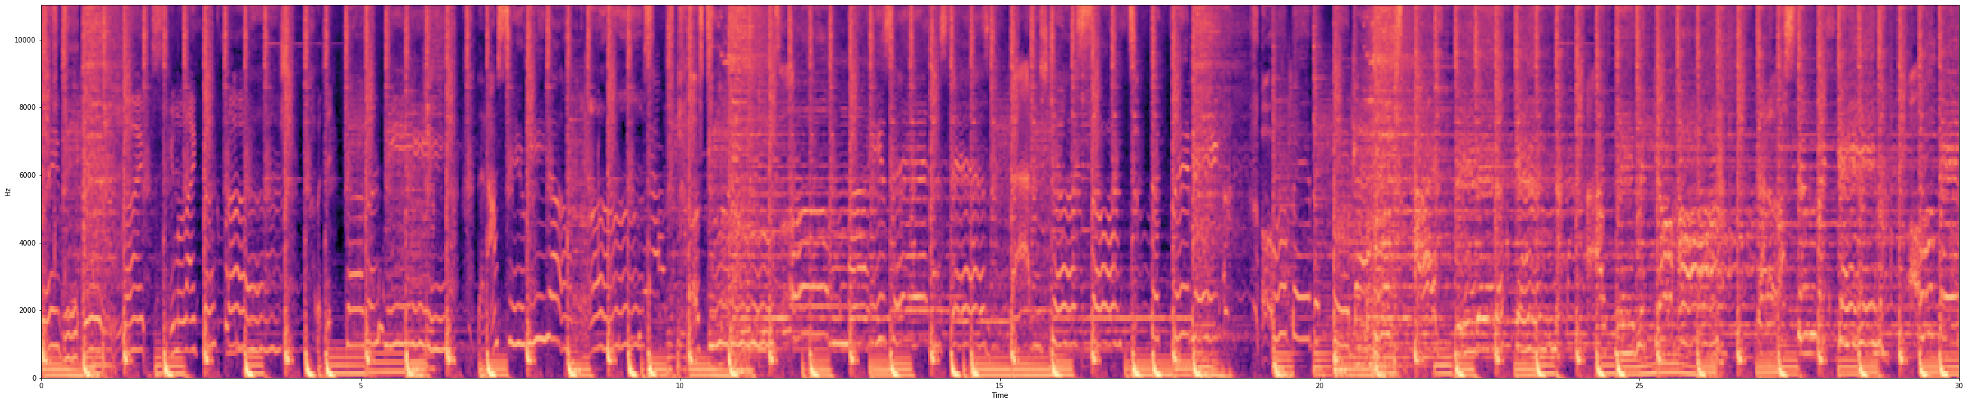
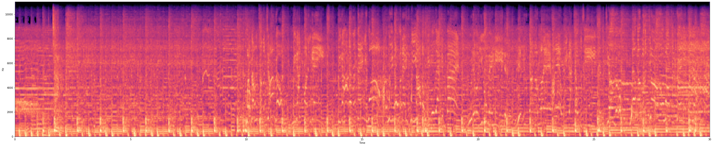
Género musical: classical
Canción: classical.00098.wav

Slide 3
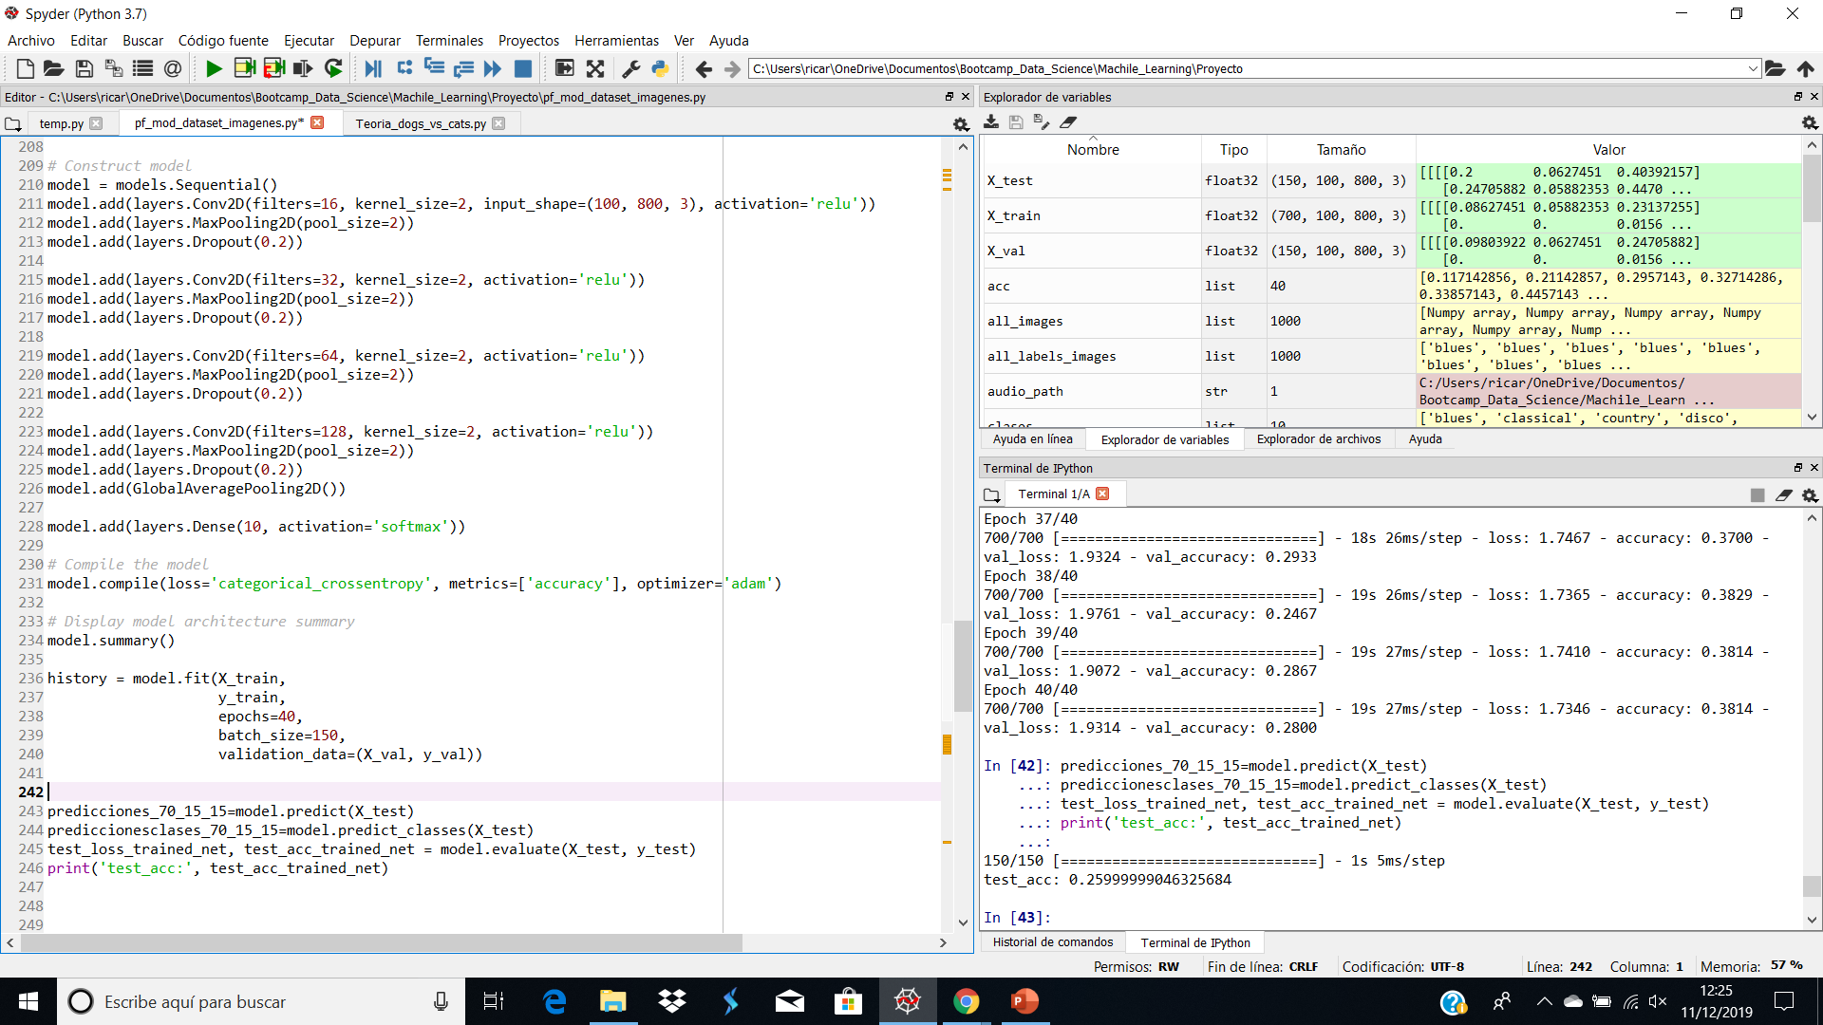
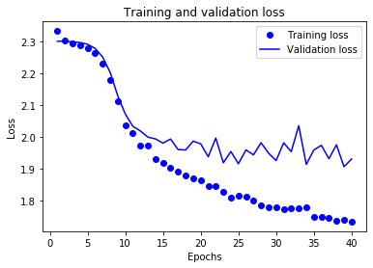

Slide 4
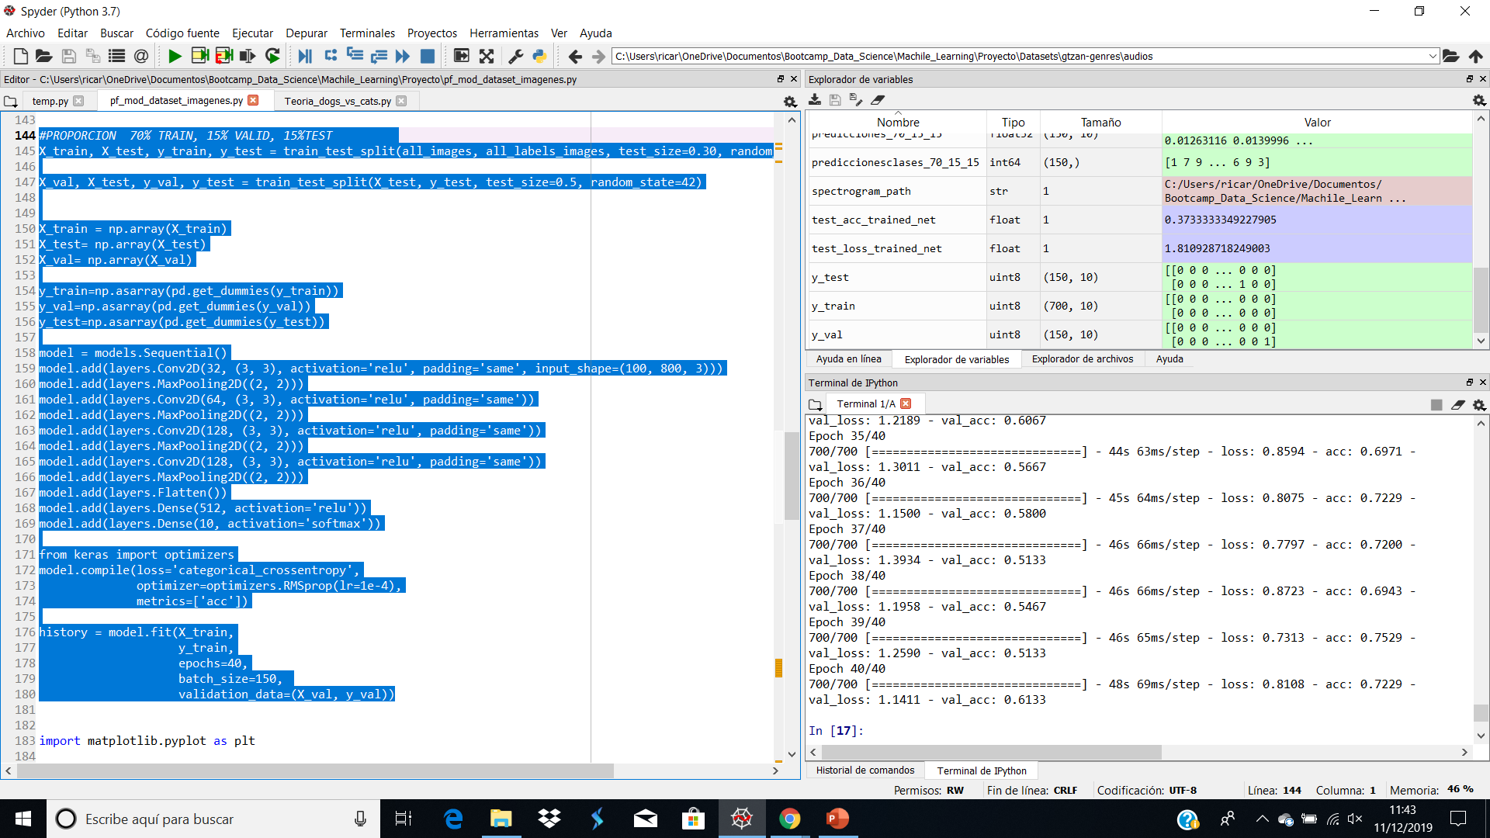
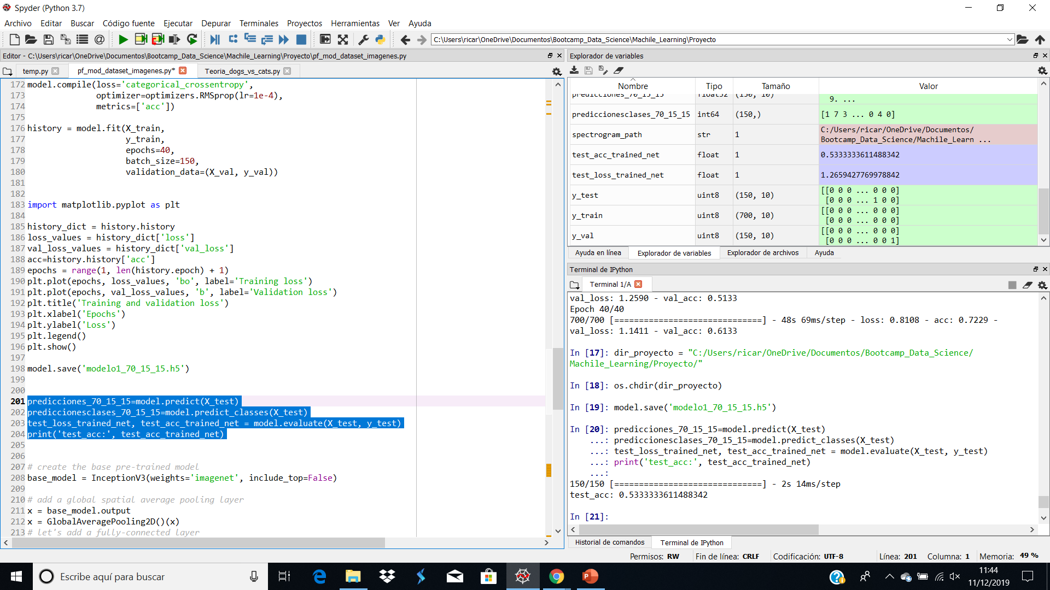
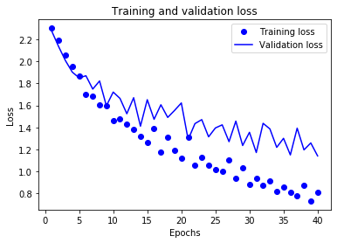

Slide 5
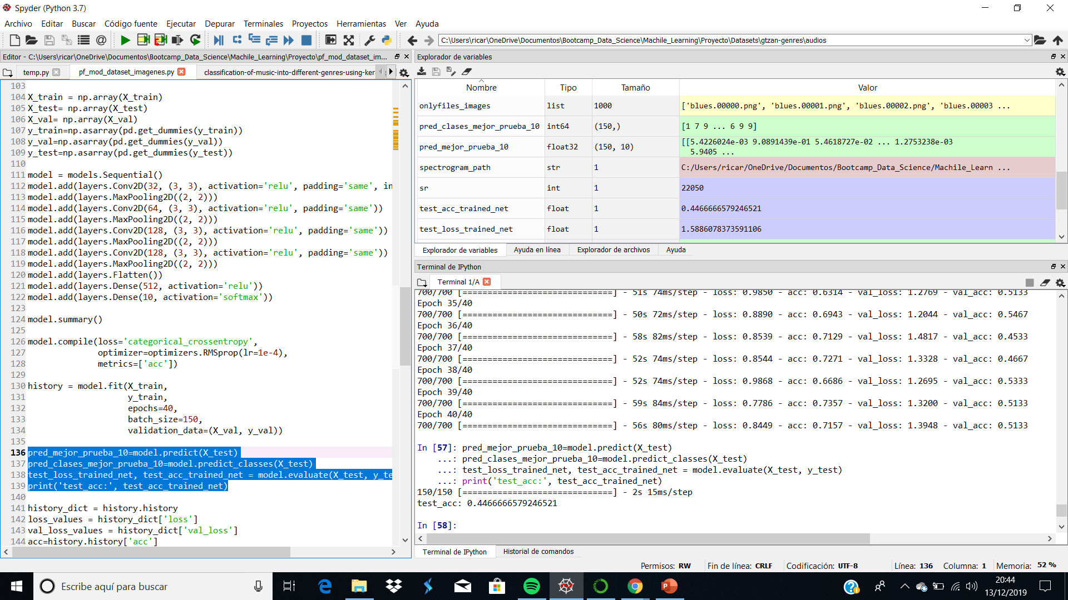
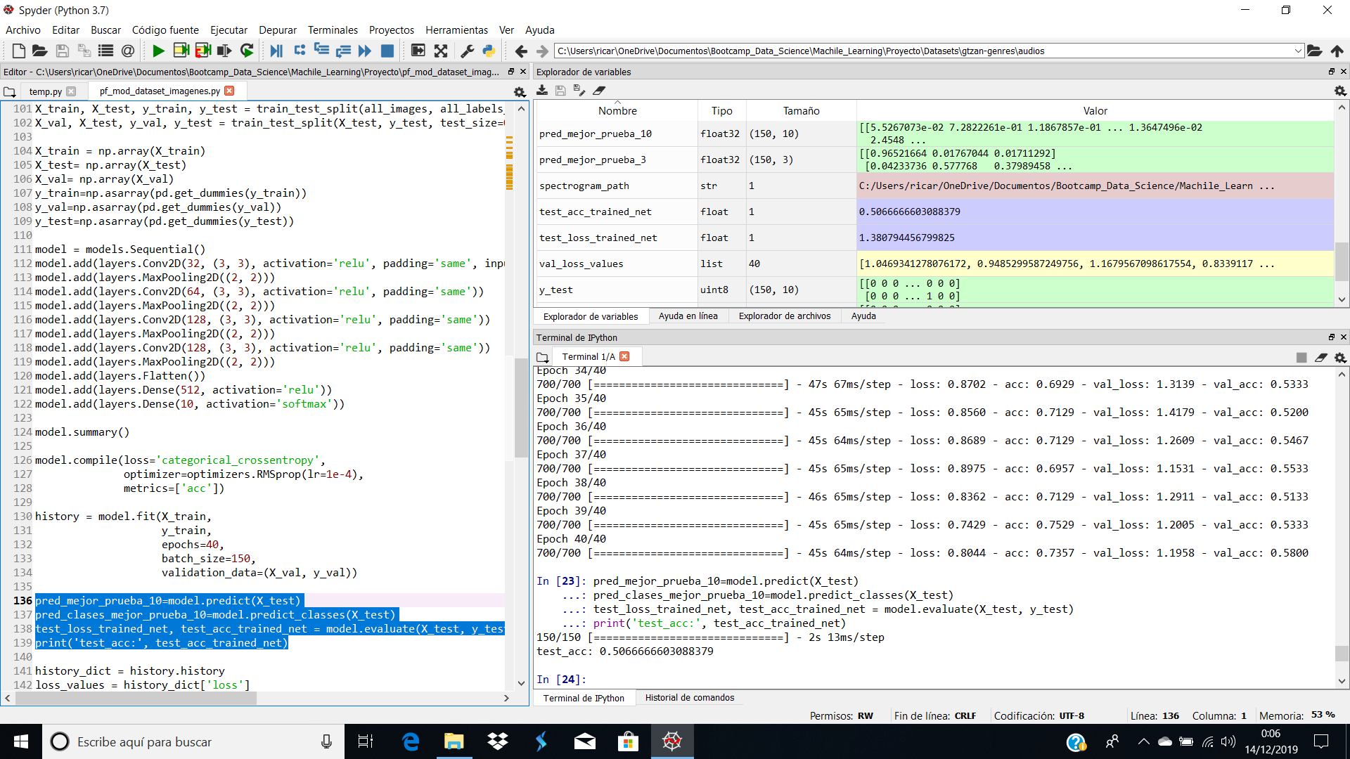
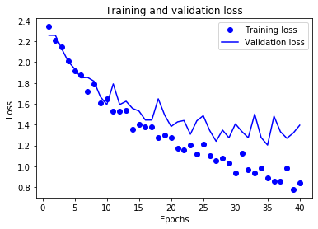
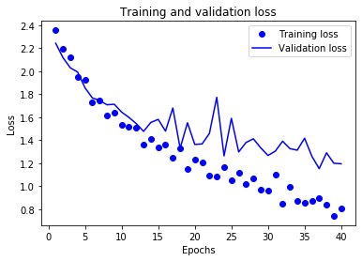

Slide 6
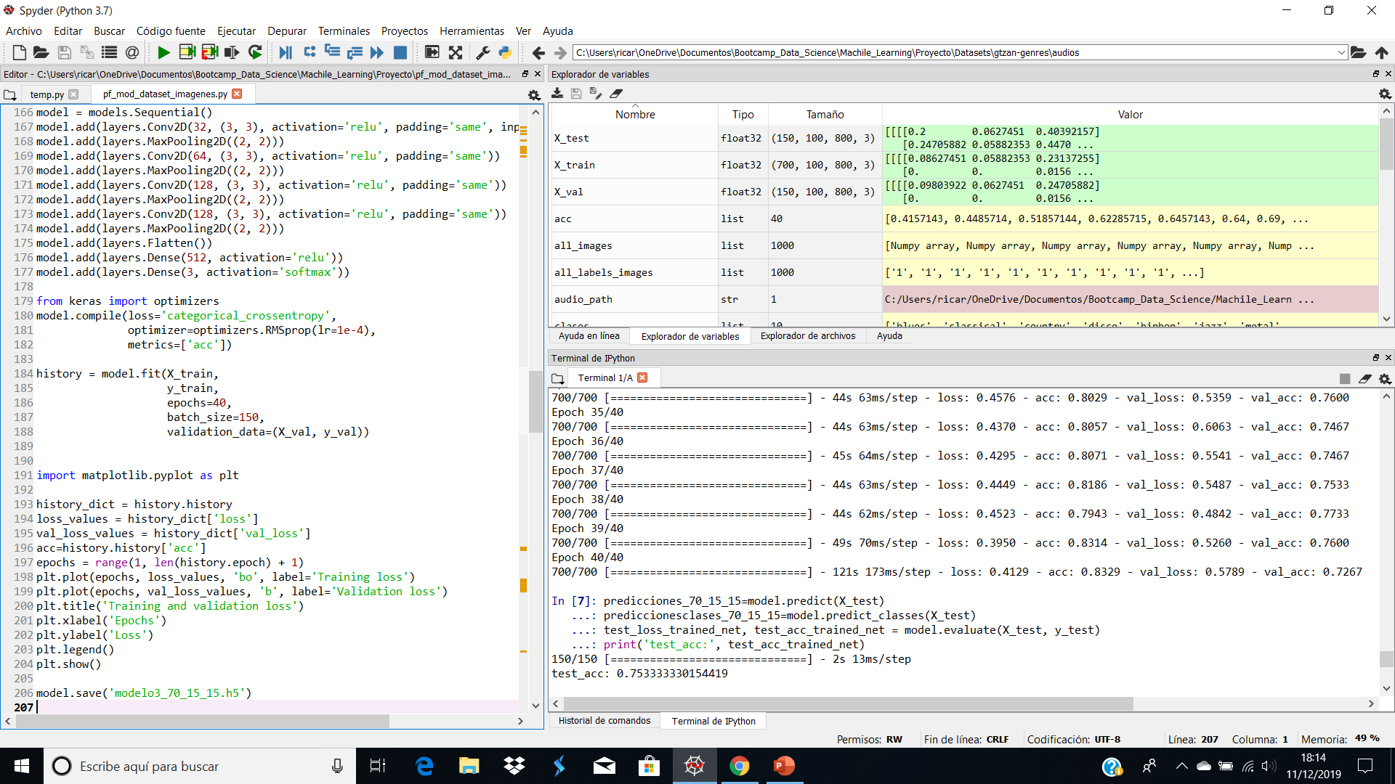
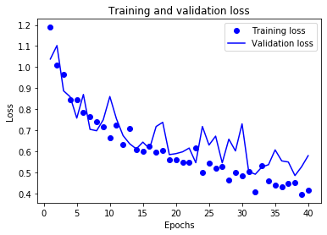

Slide 7
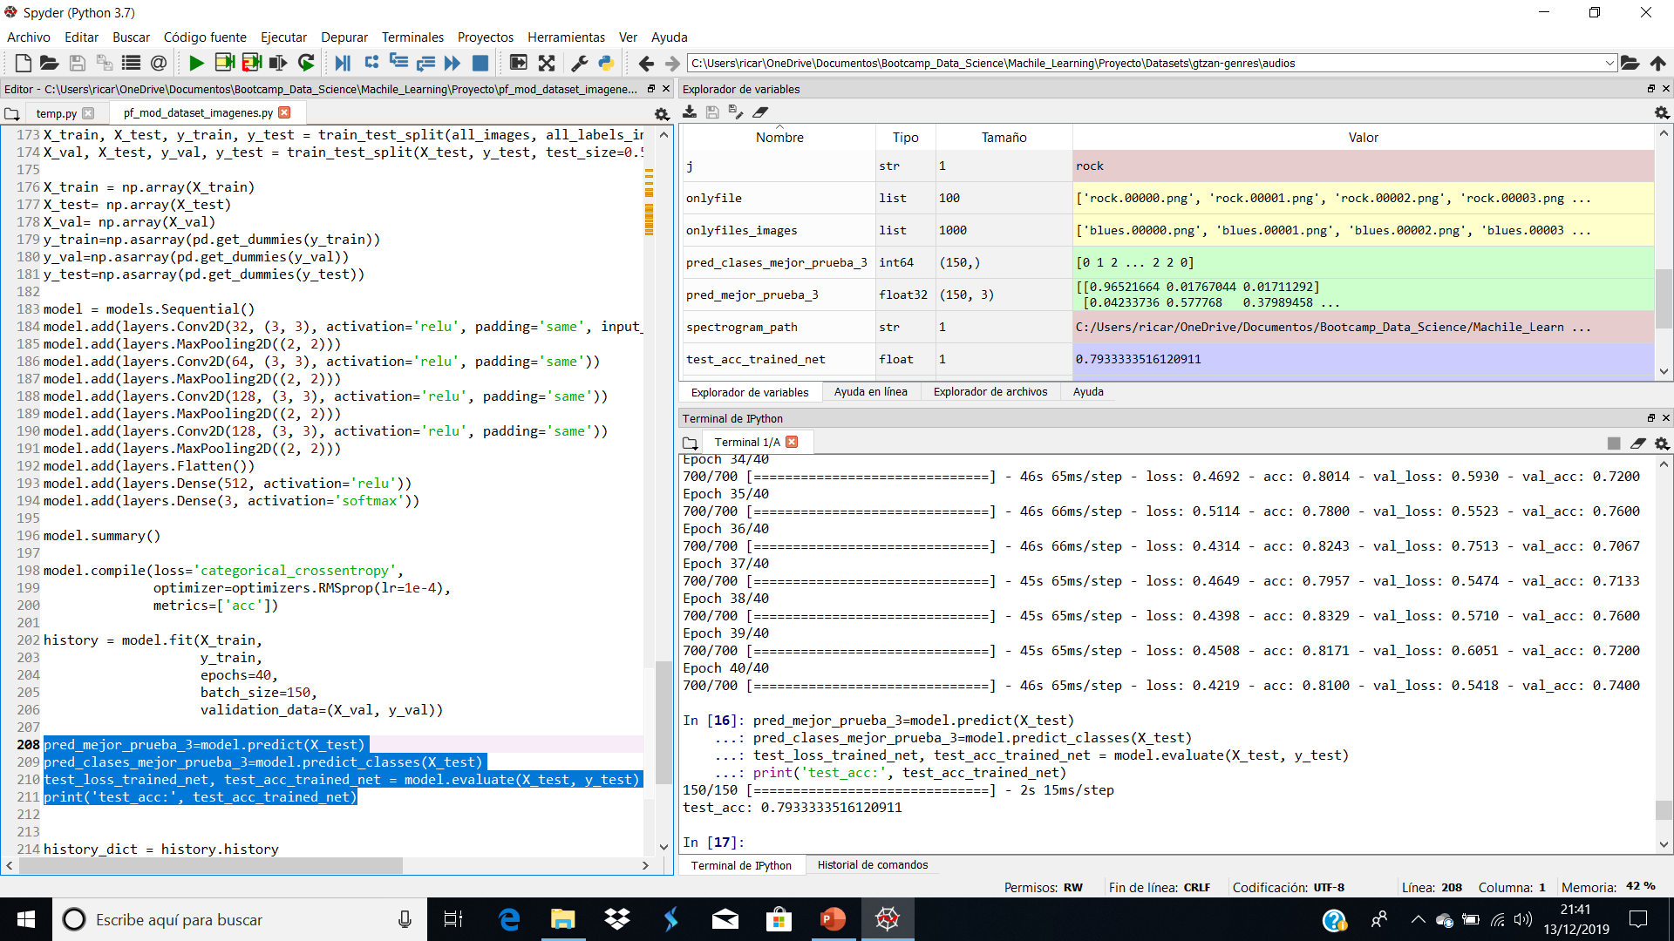
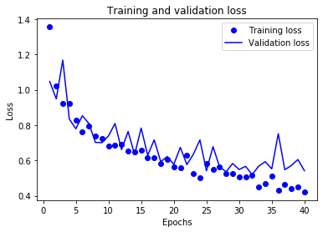

Slide 8
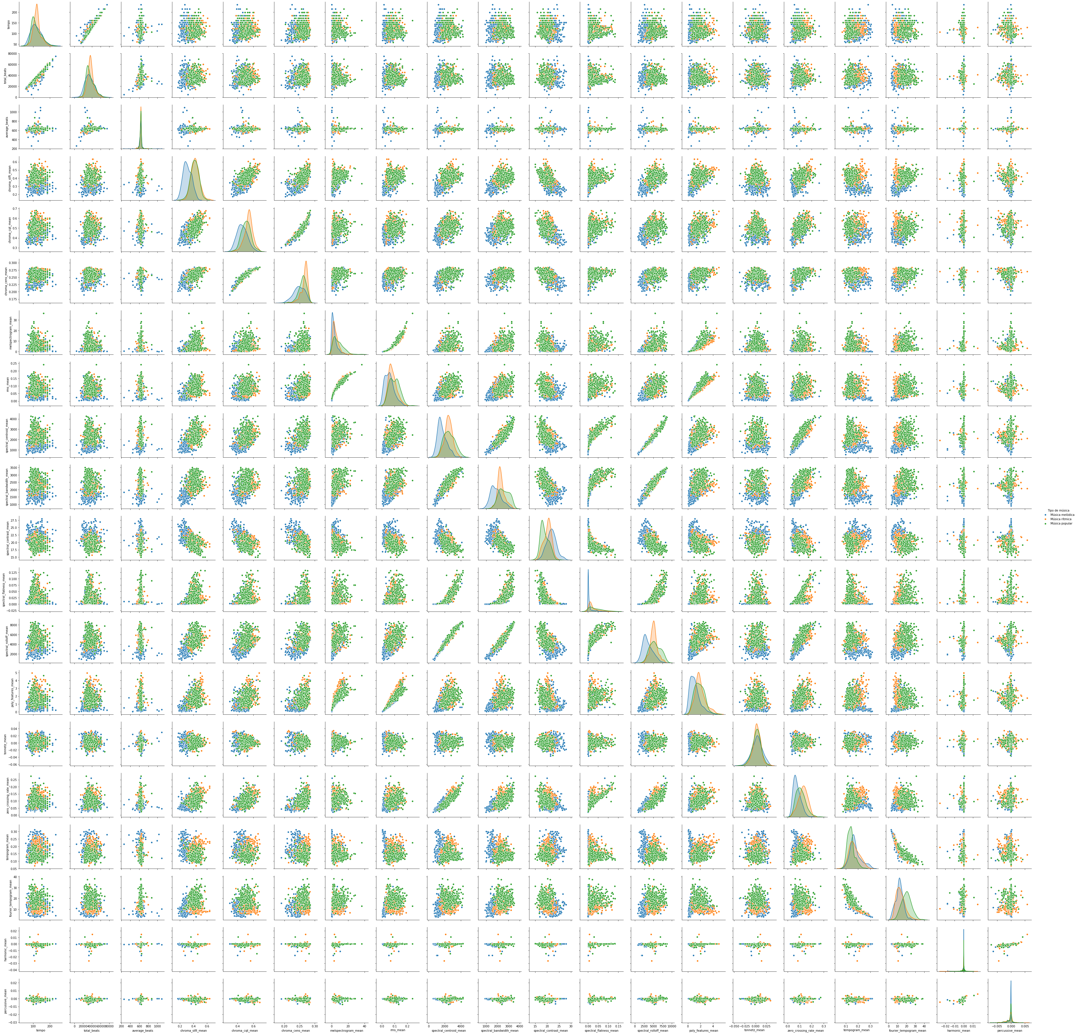

Slide 9
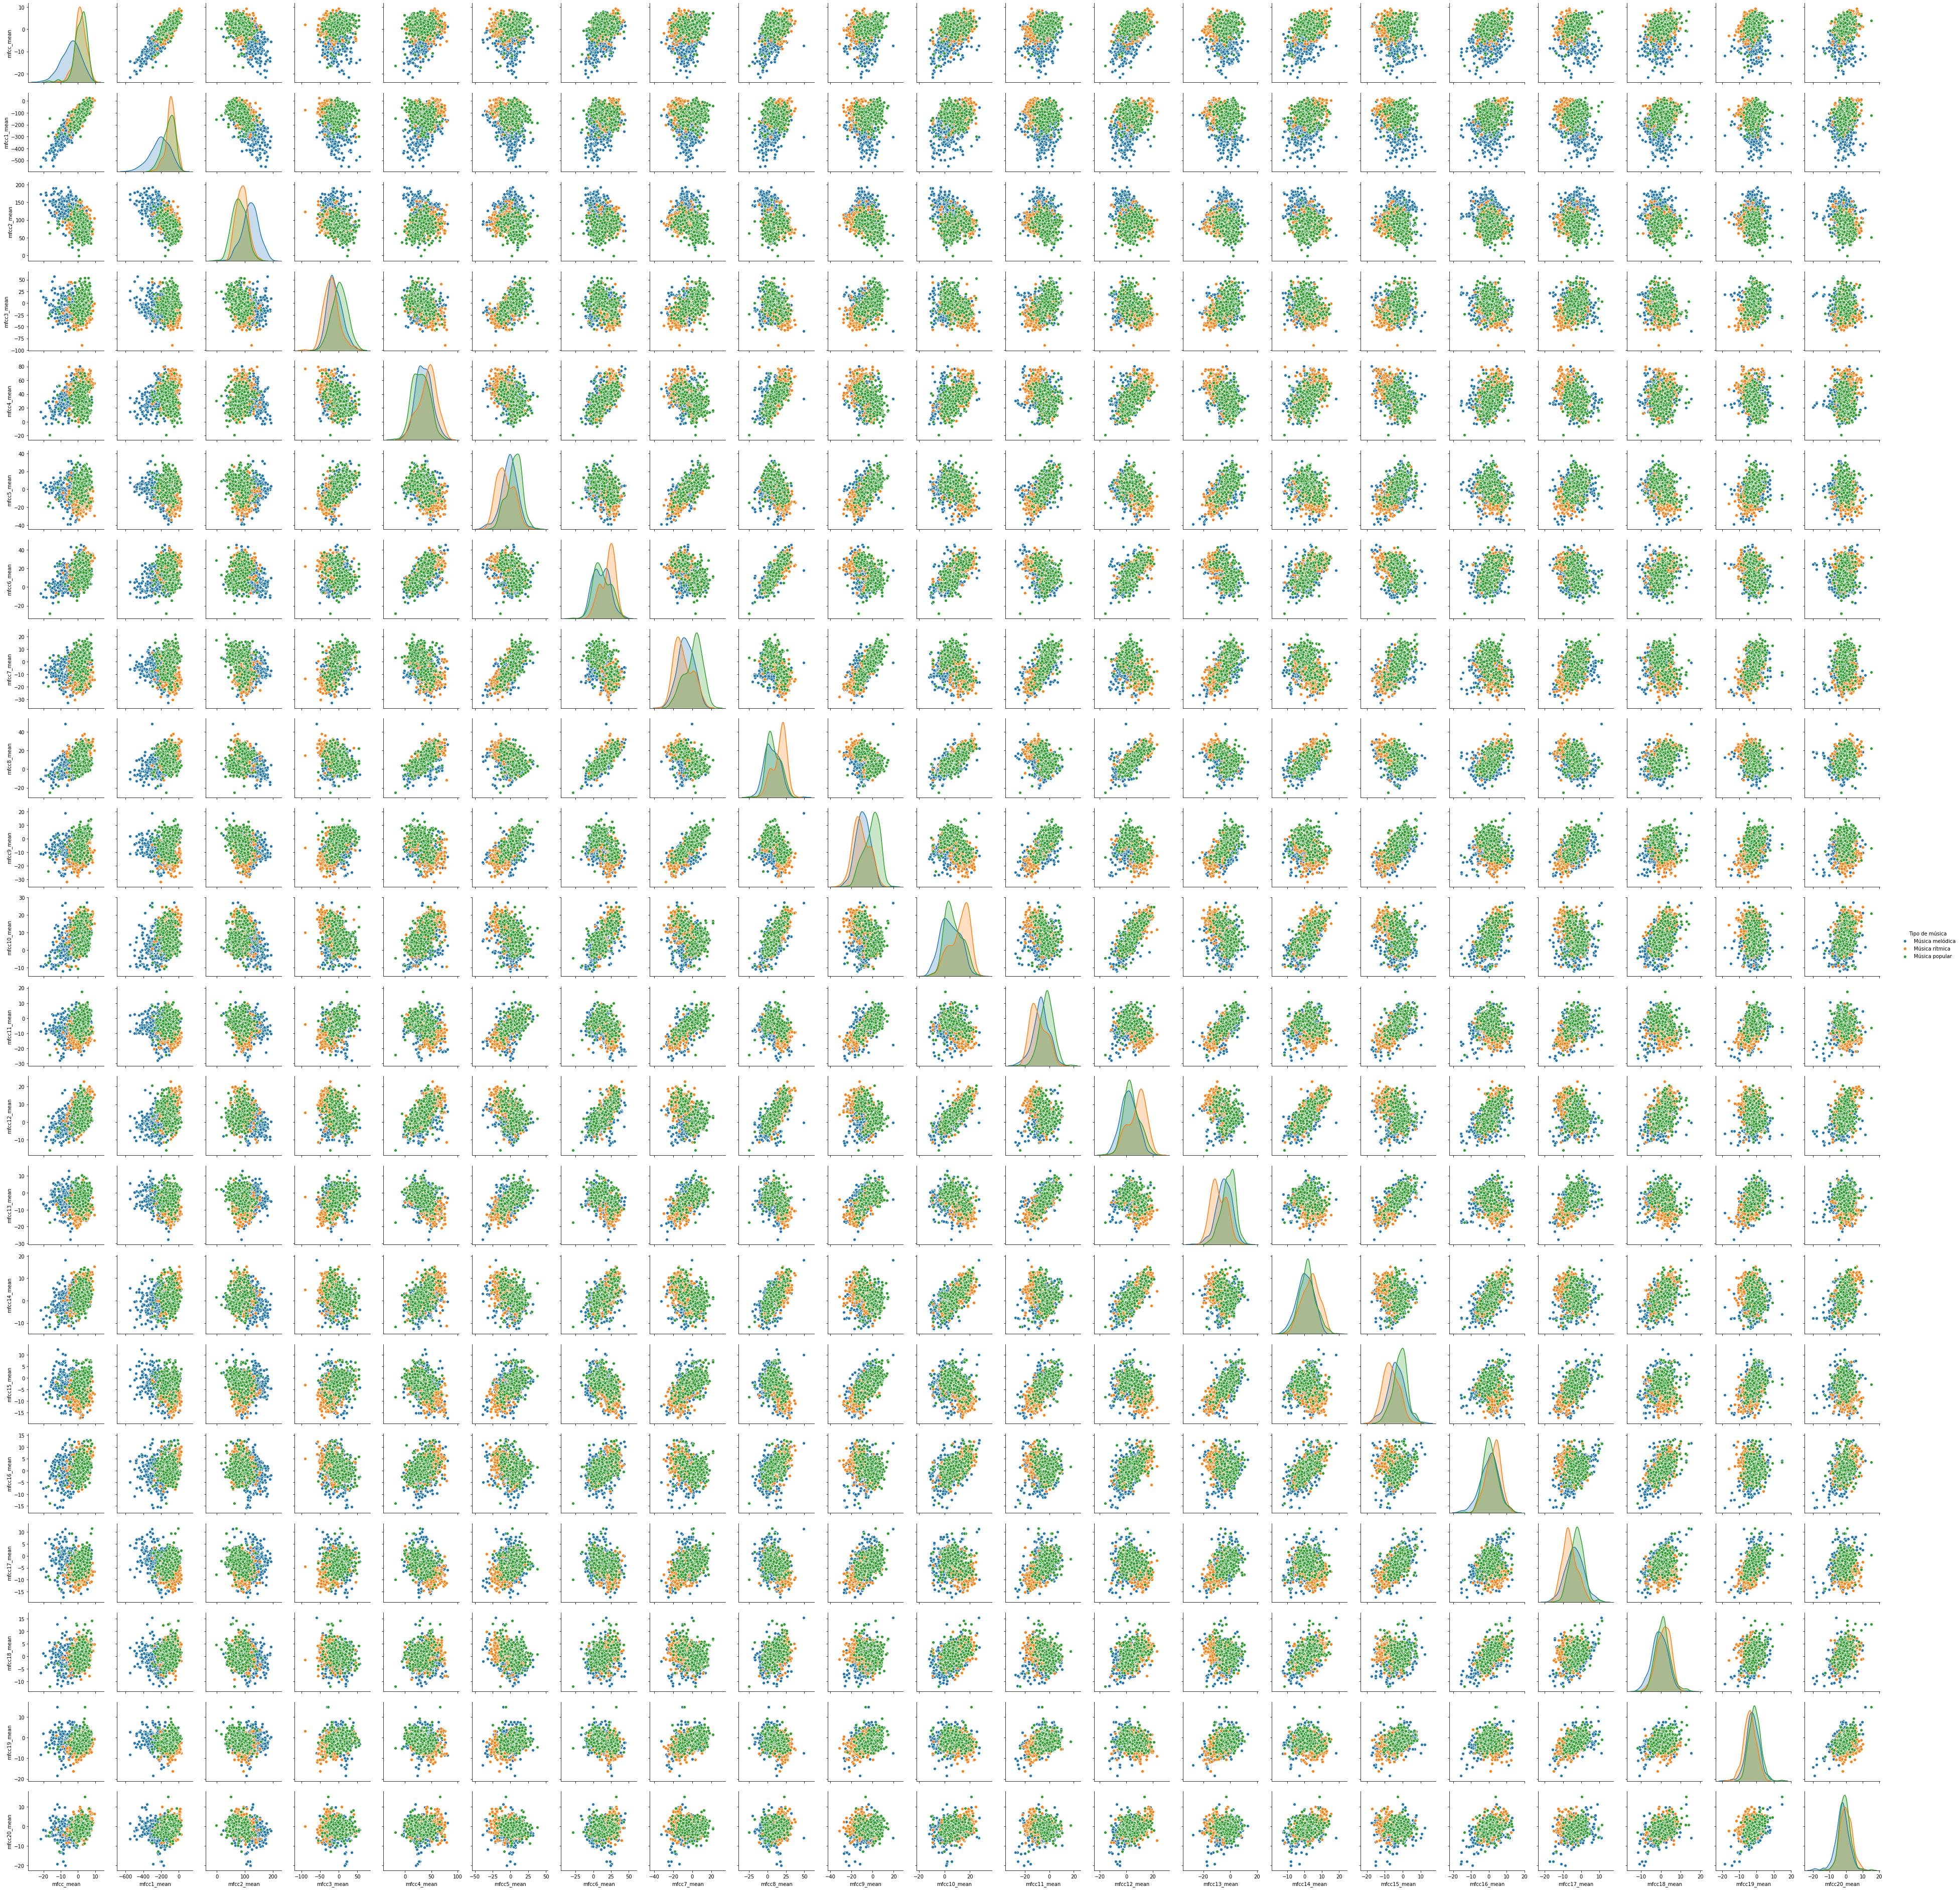

Slide 10
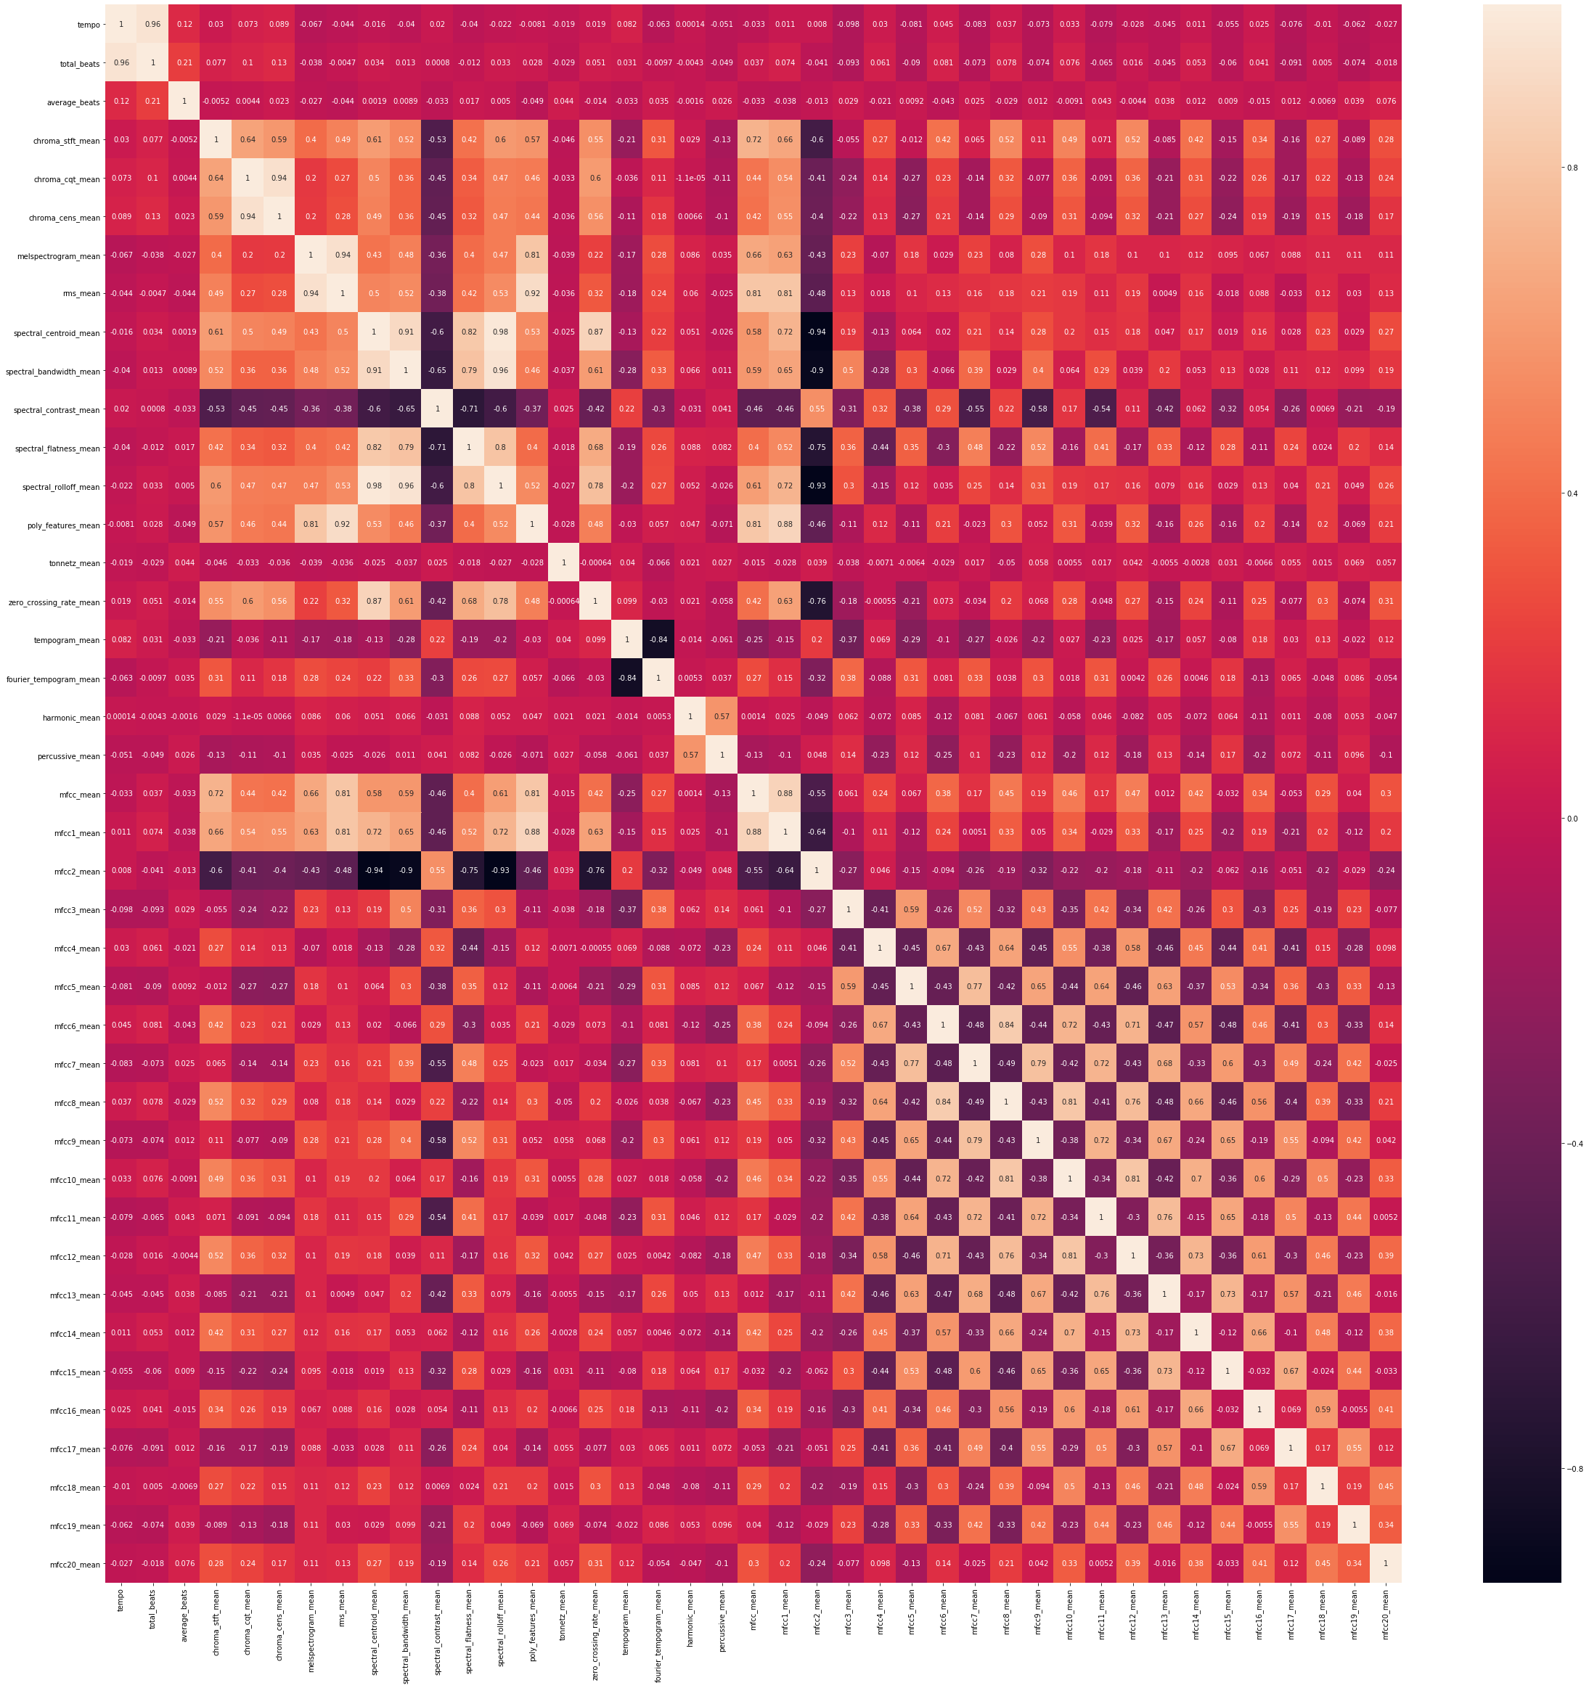
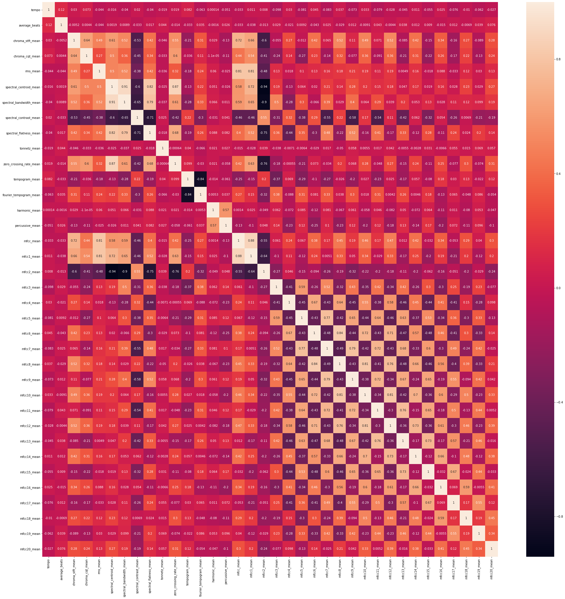
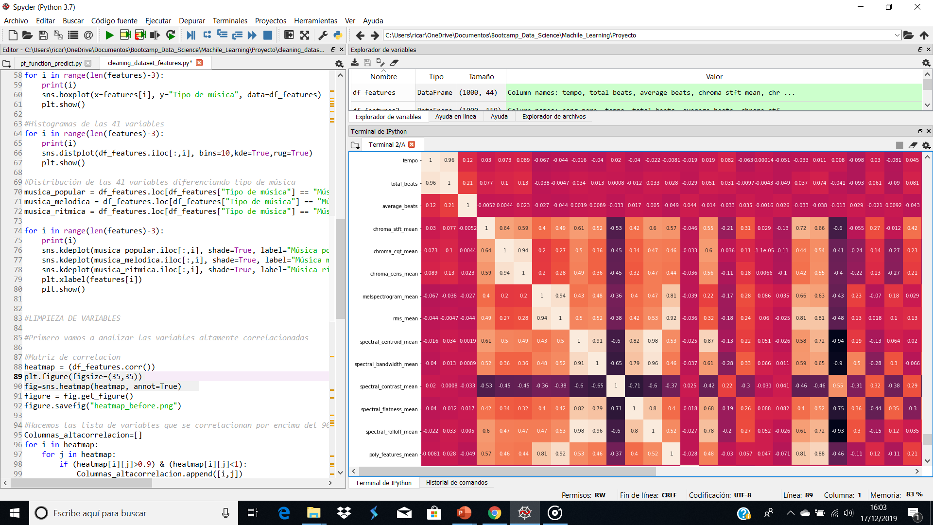
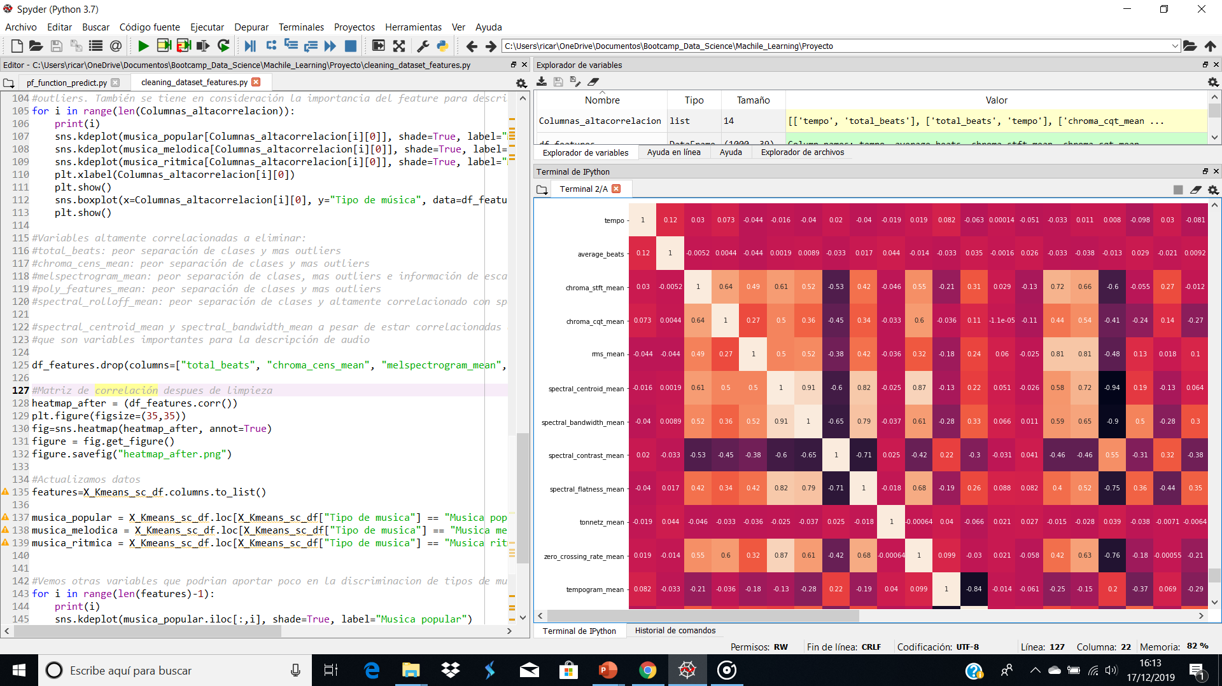

Slide 11
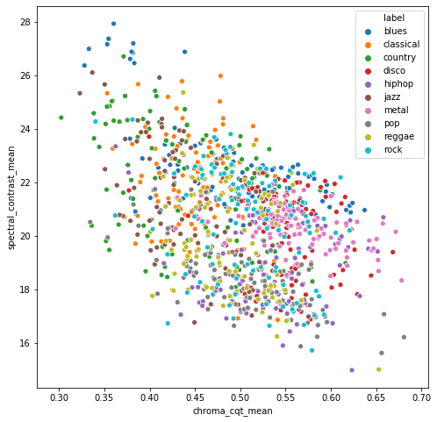
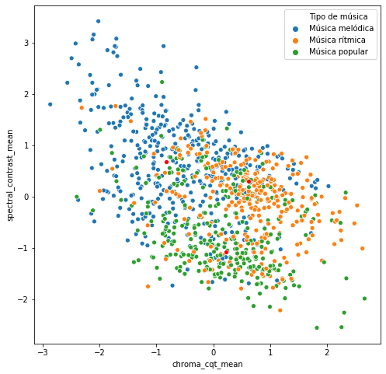
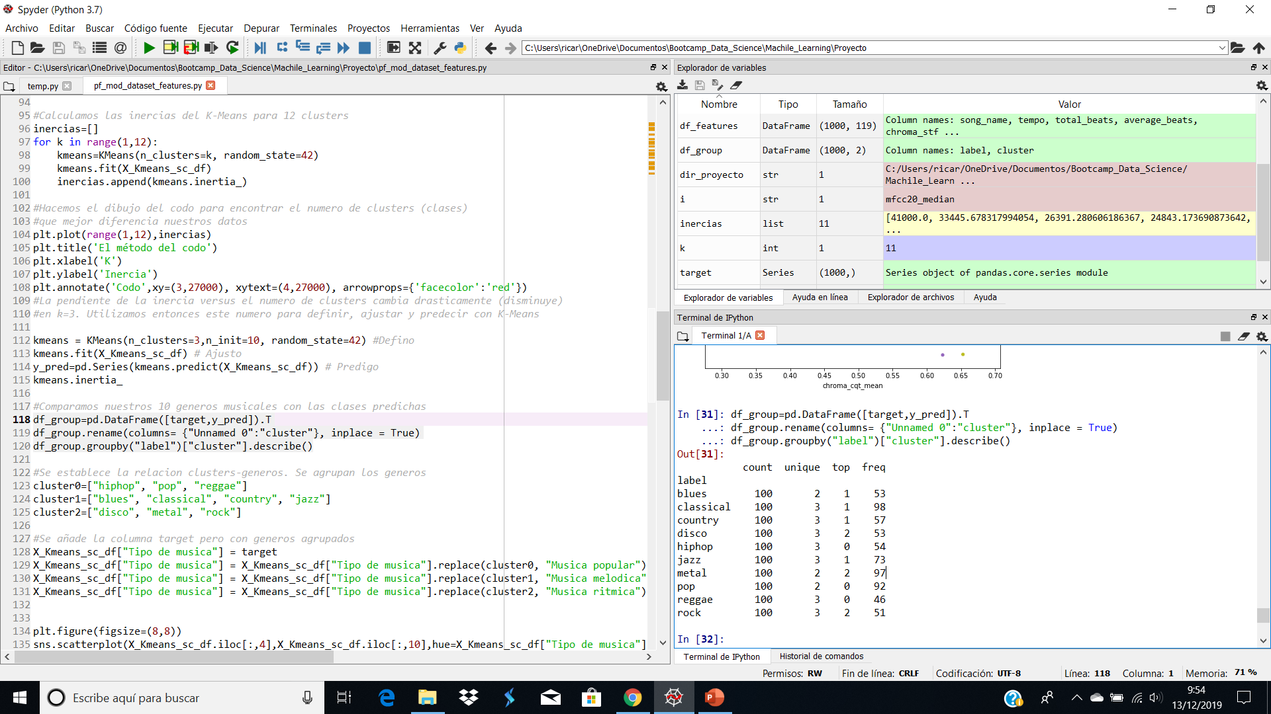
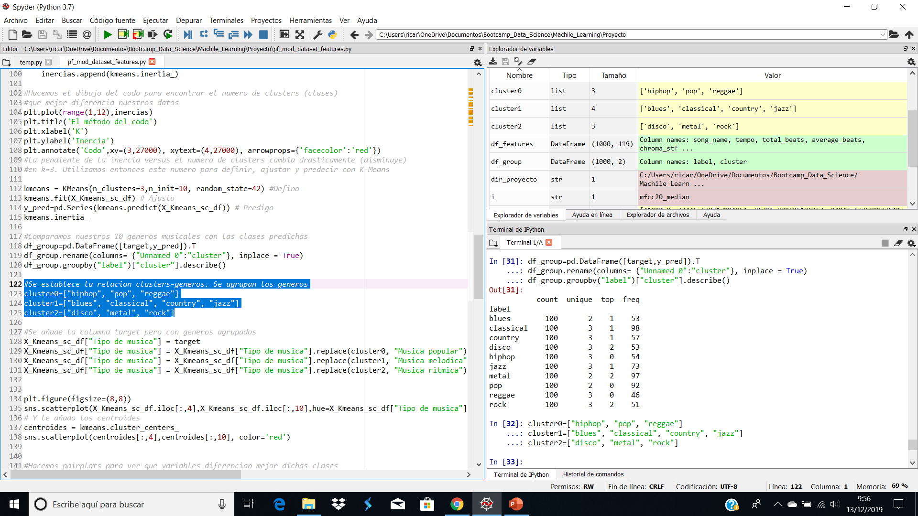

Slide 12
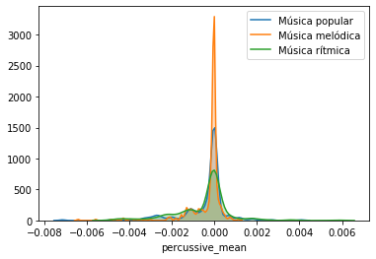
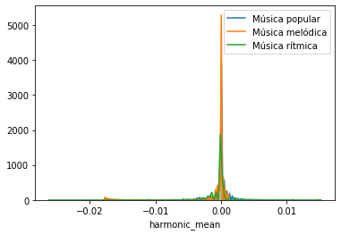
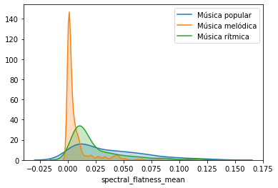
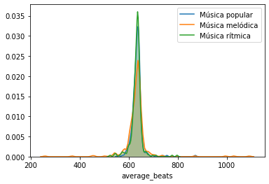

Slide 13
RESULTADOS MODELOS IMAGENES

Slide 14
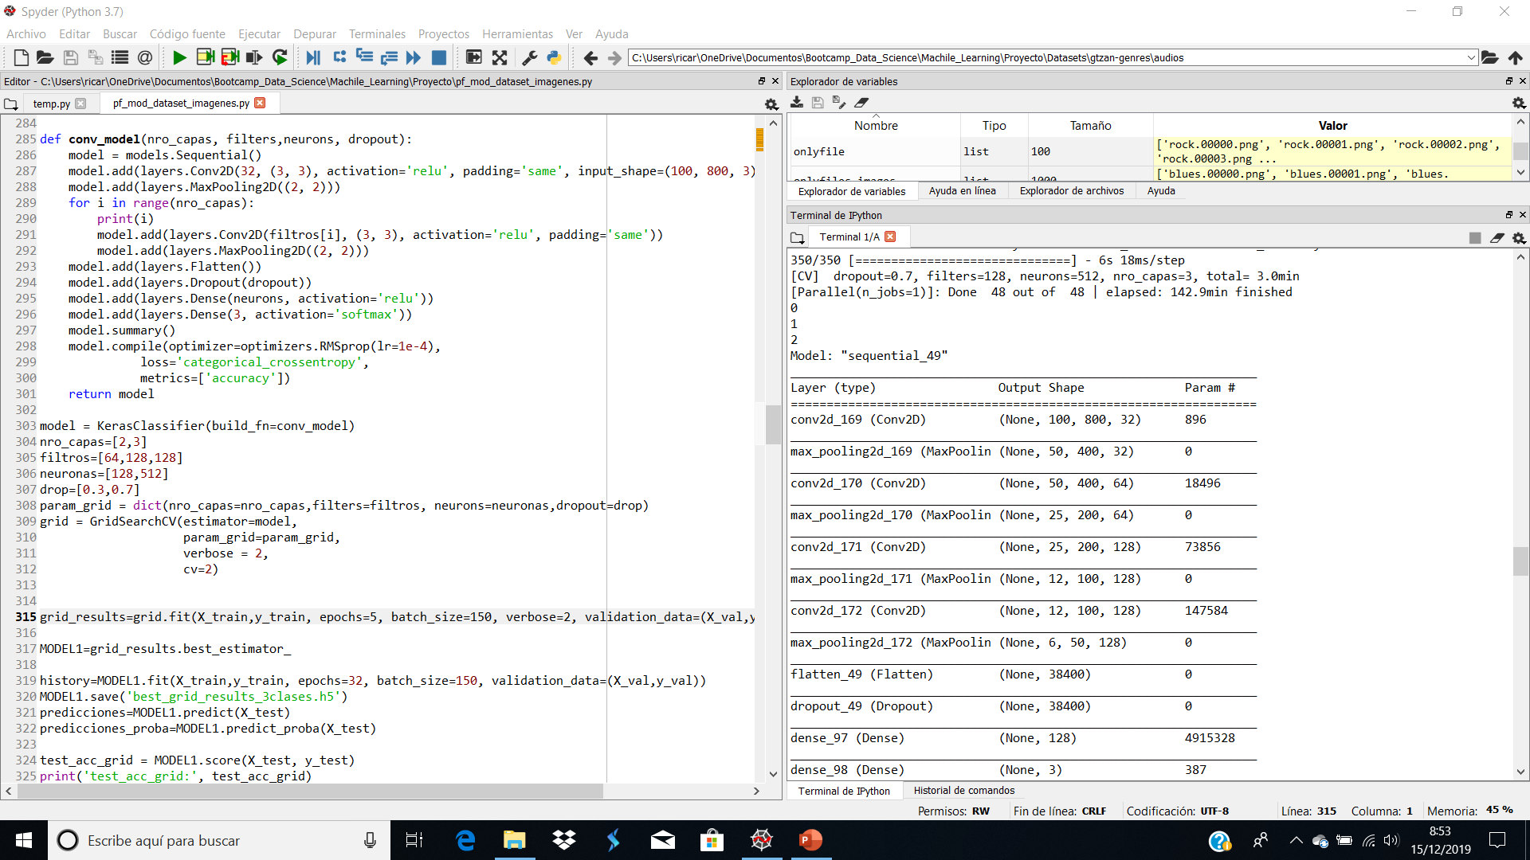

Slide 15
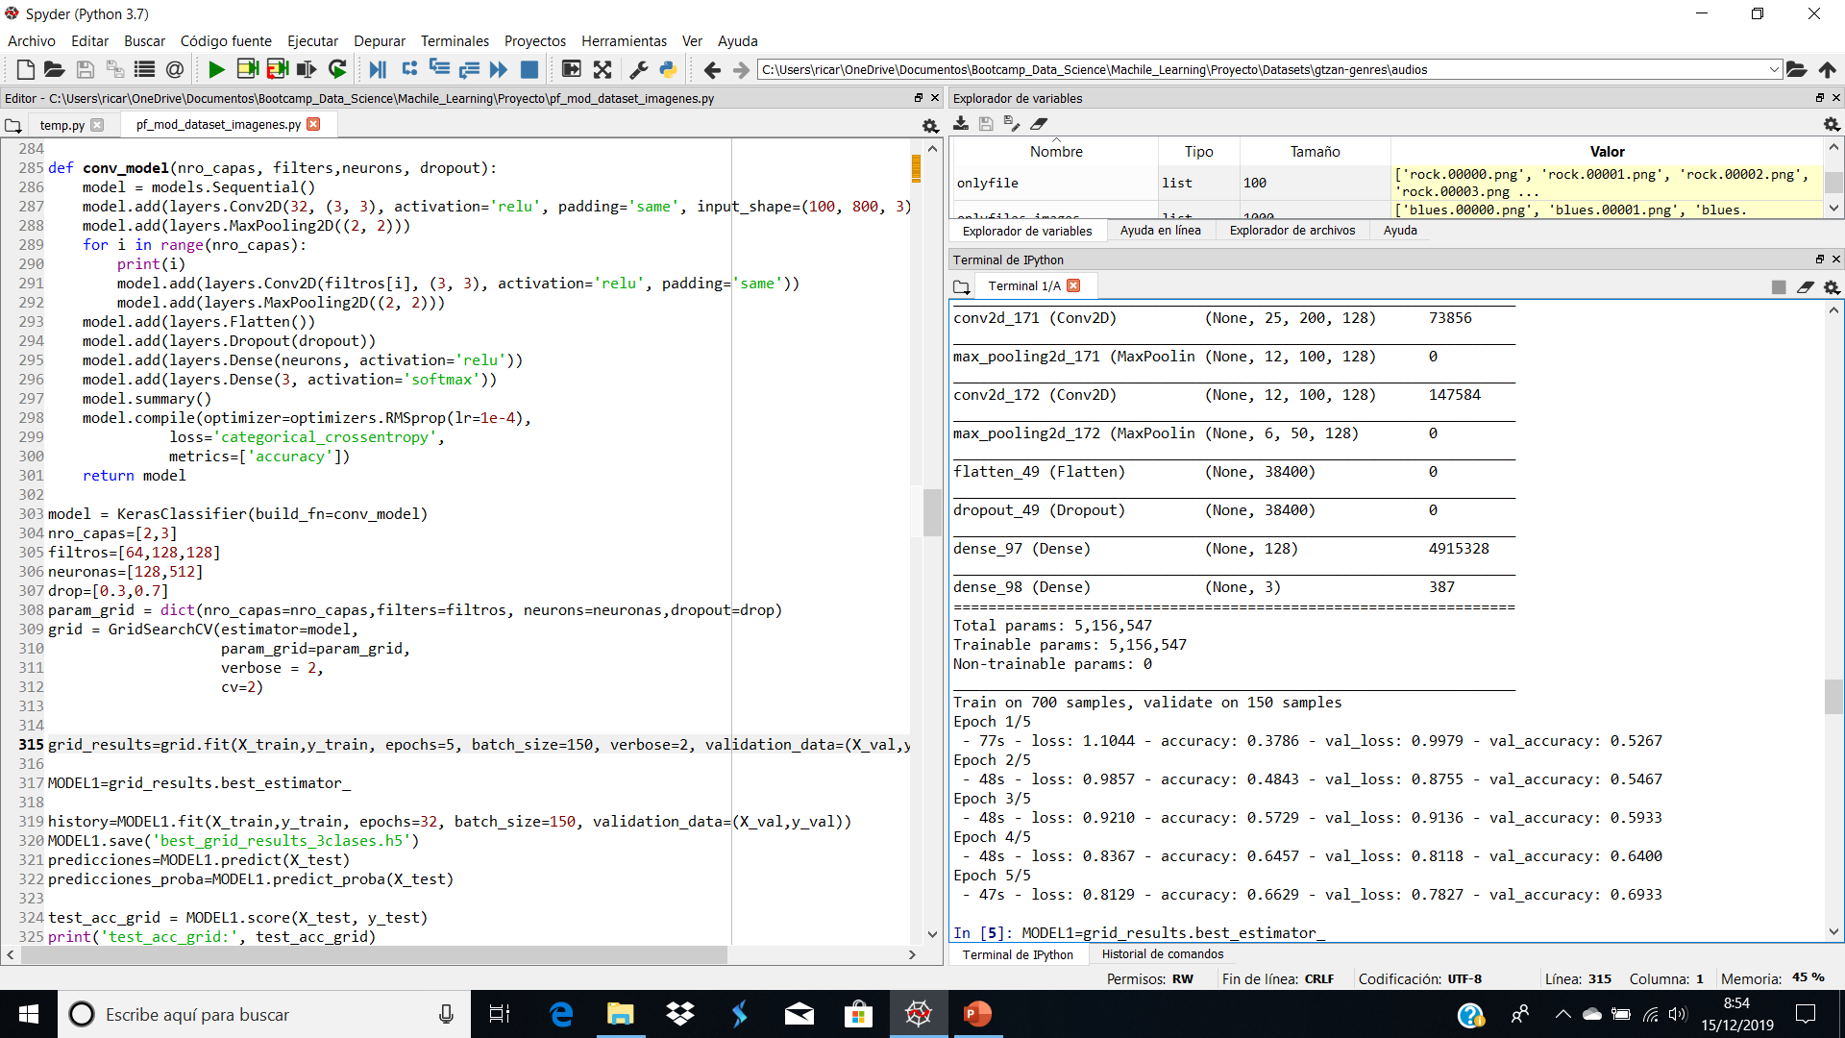

Slide 16
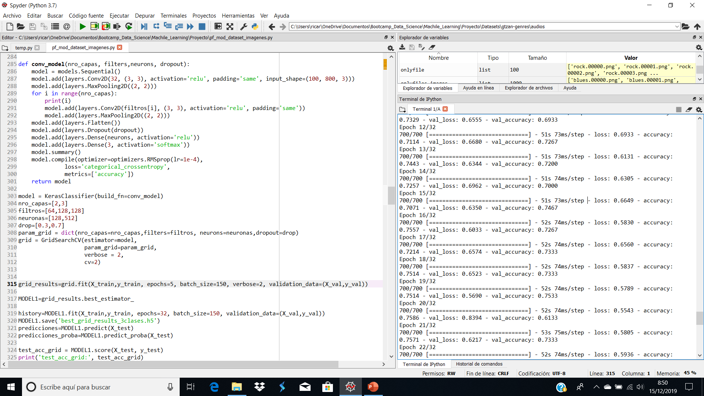

Slide 17
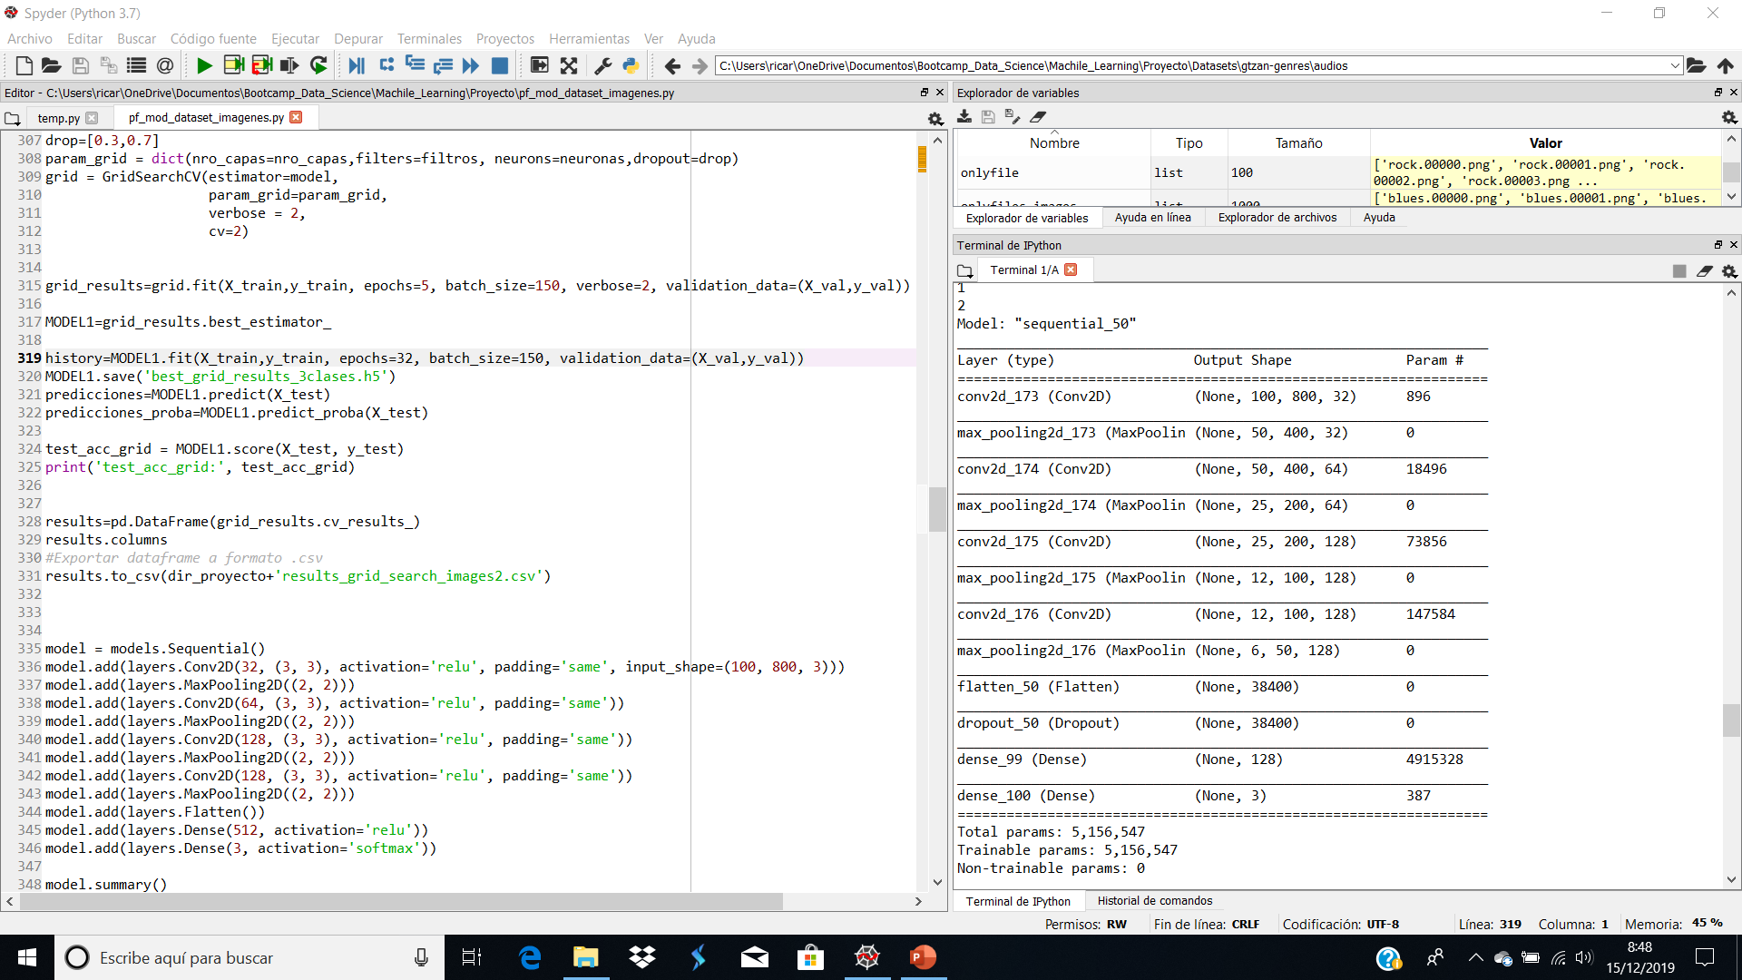

Slide 18
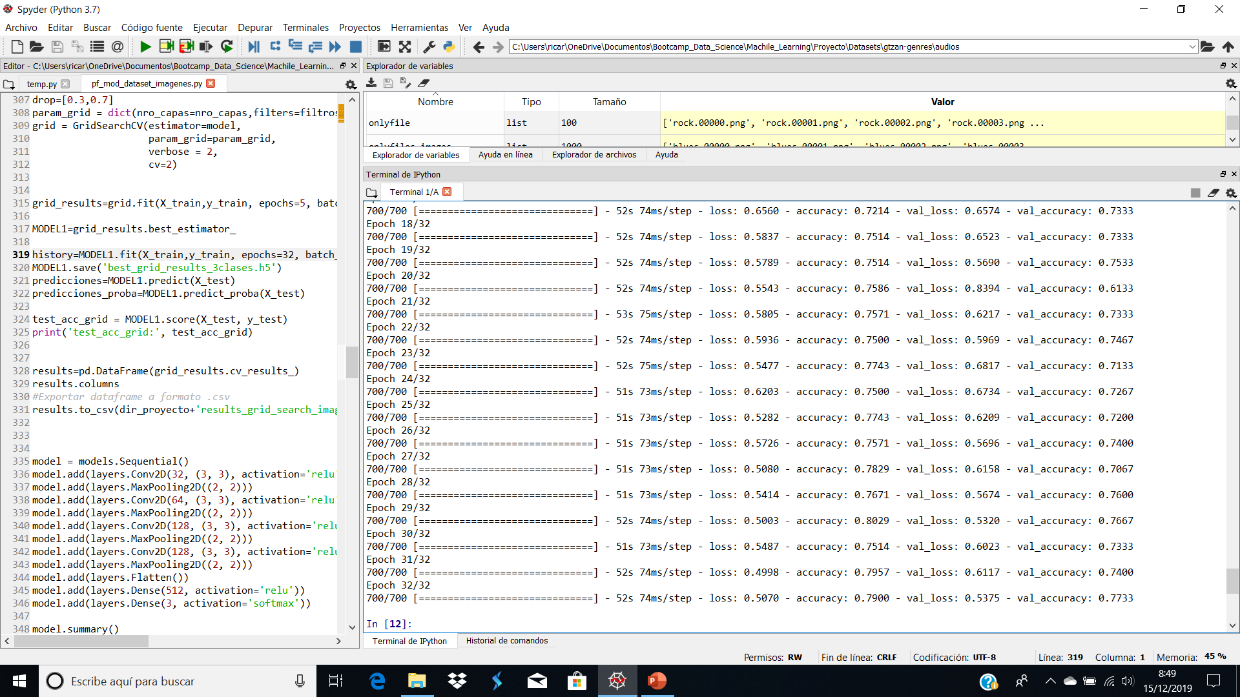
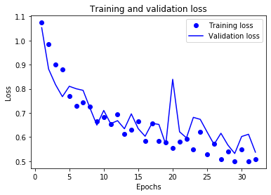

Slide 19
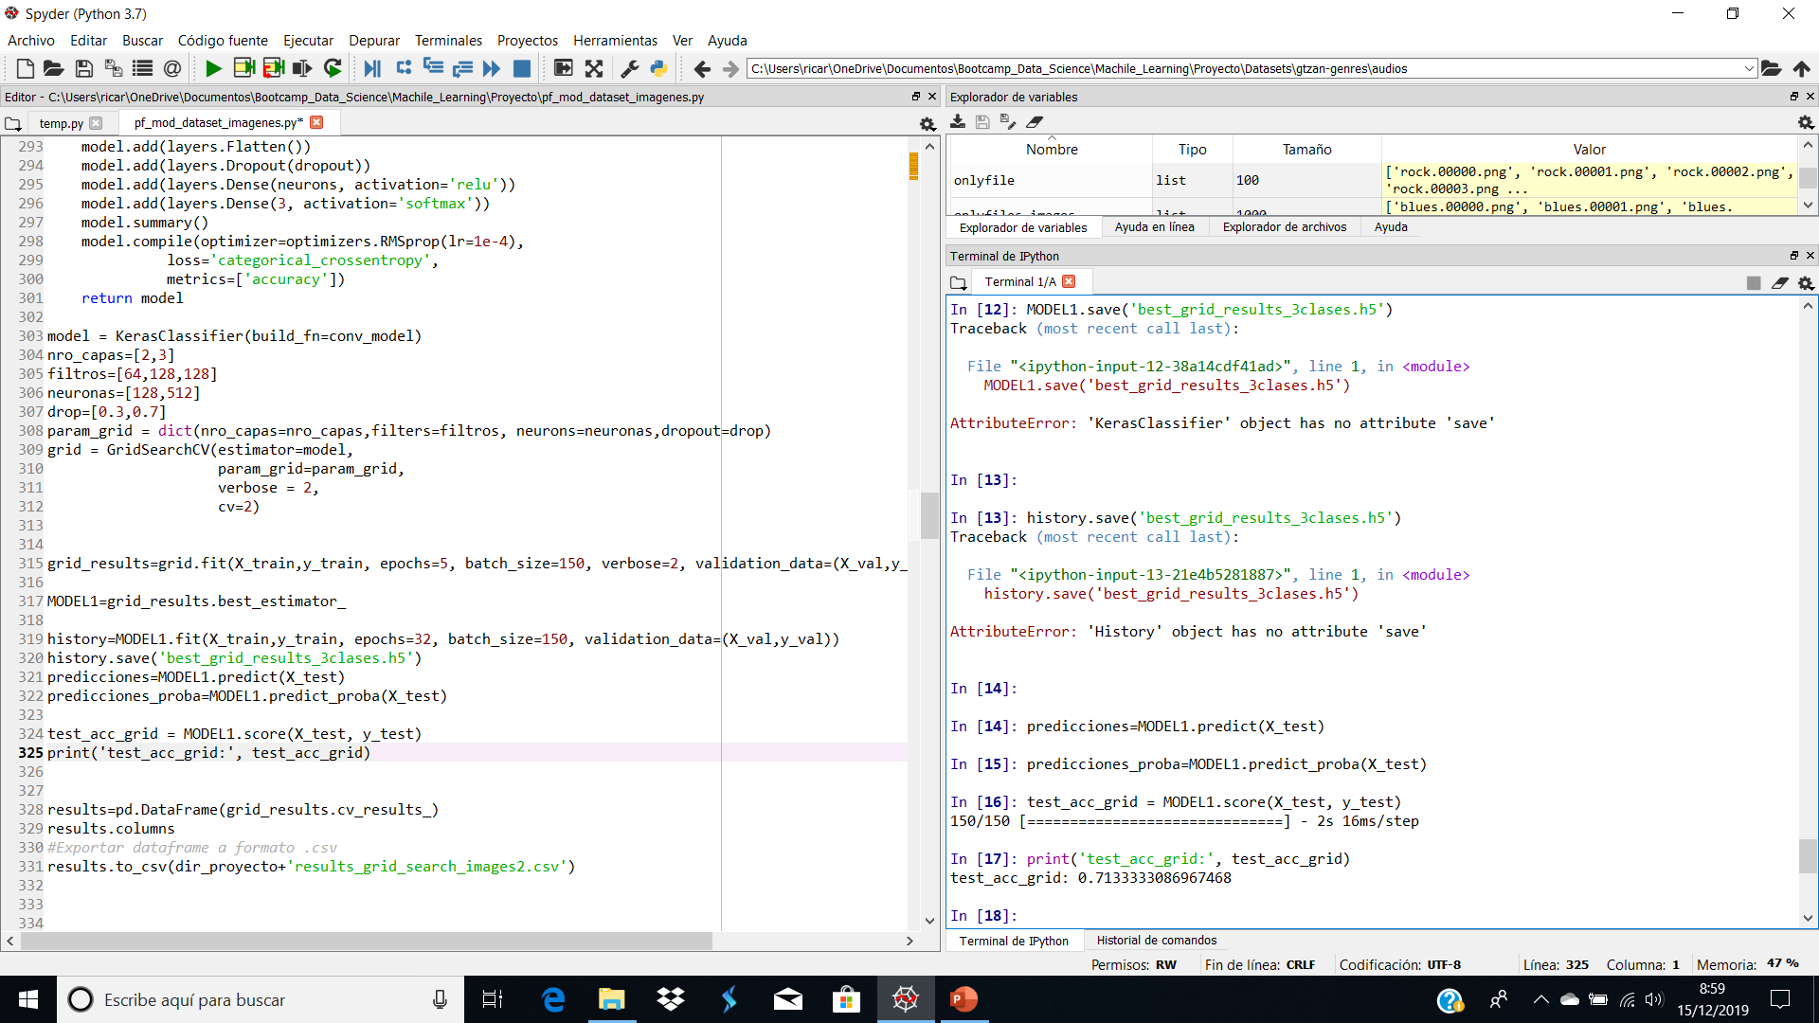
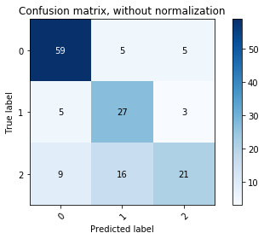

Slide 20
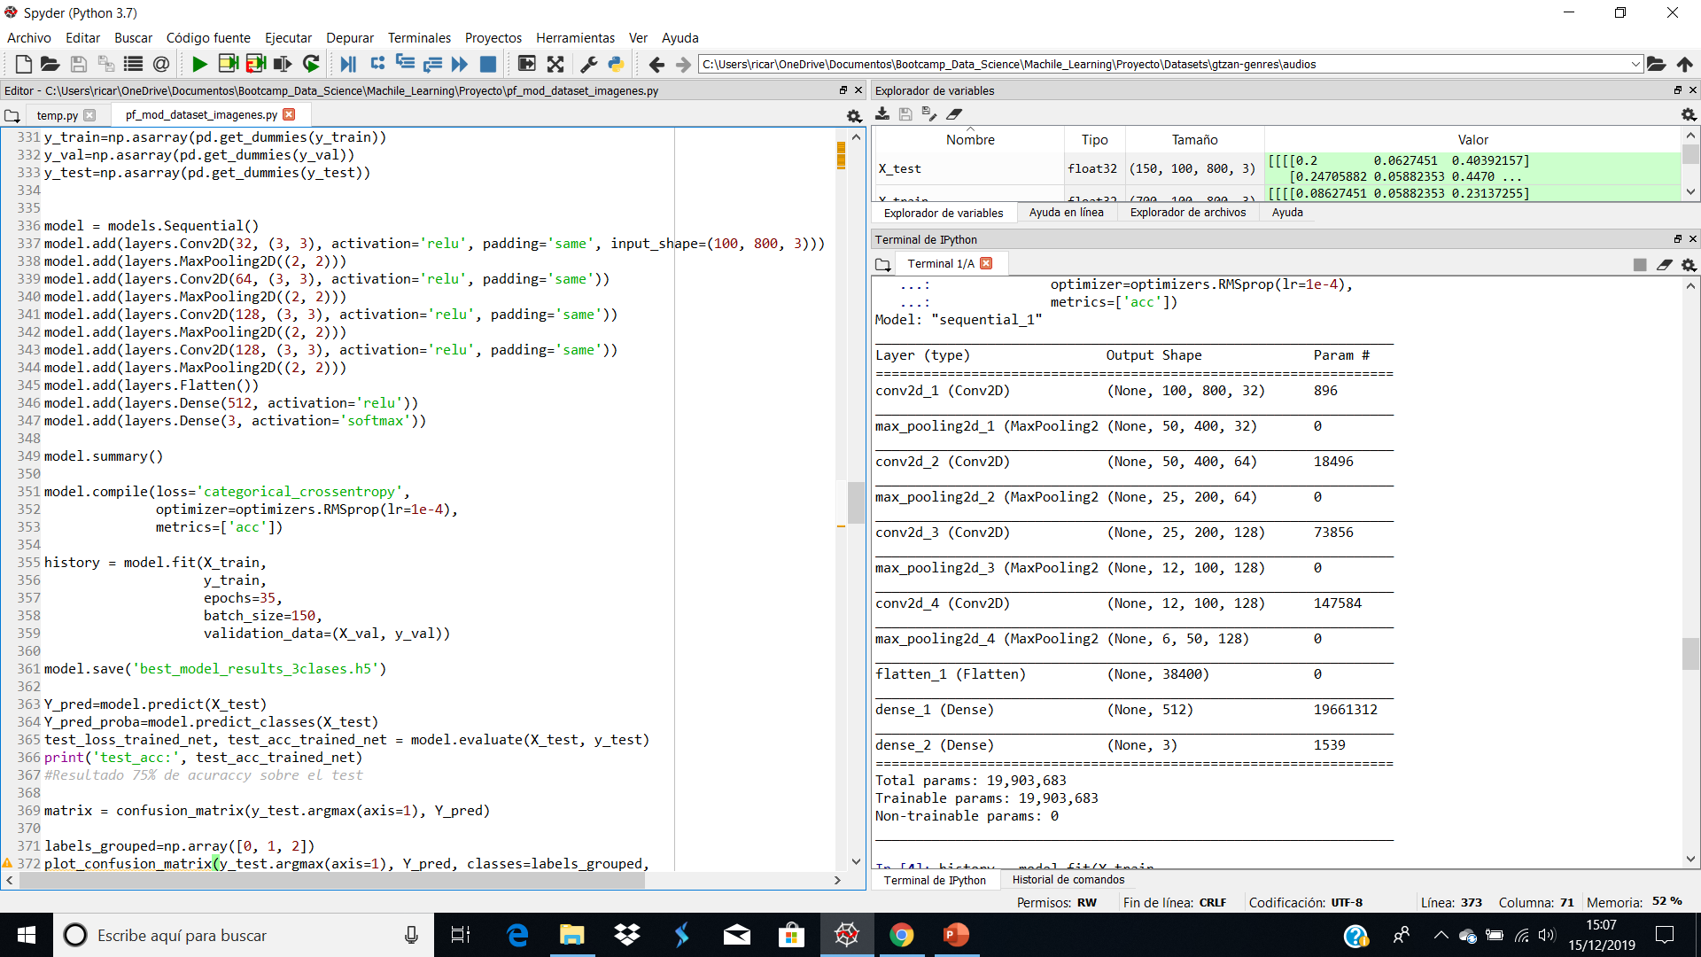

Slide 21
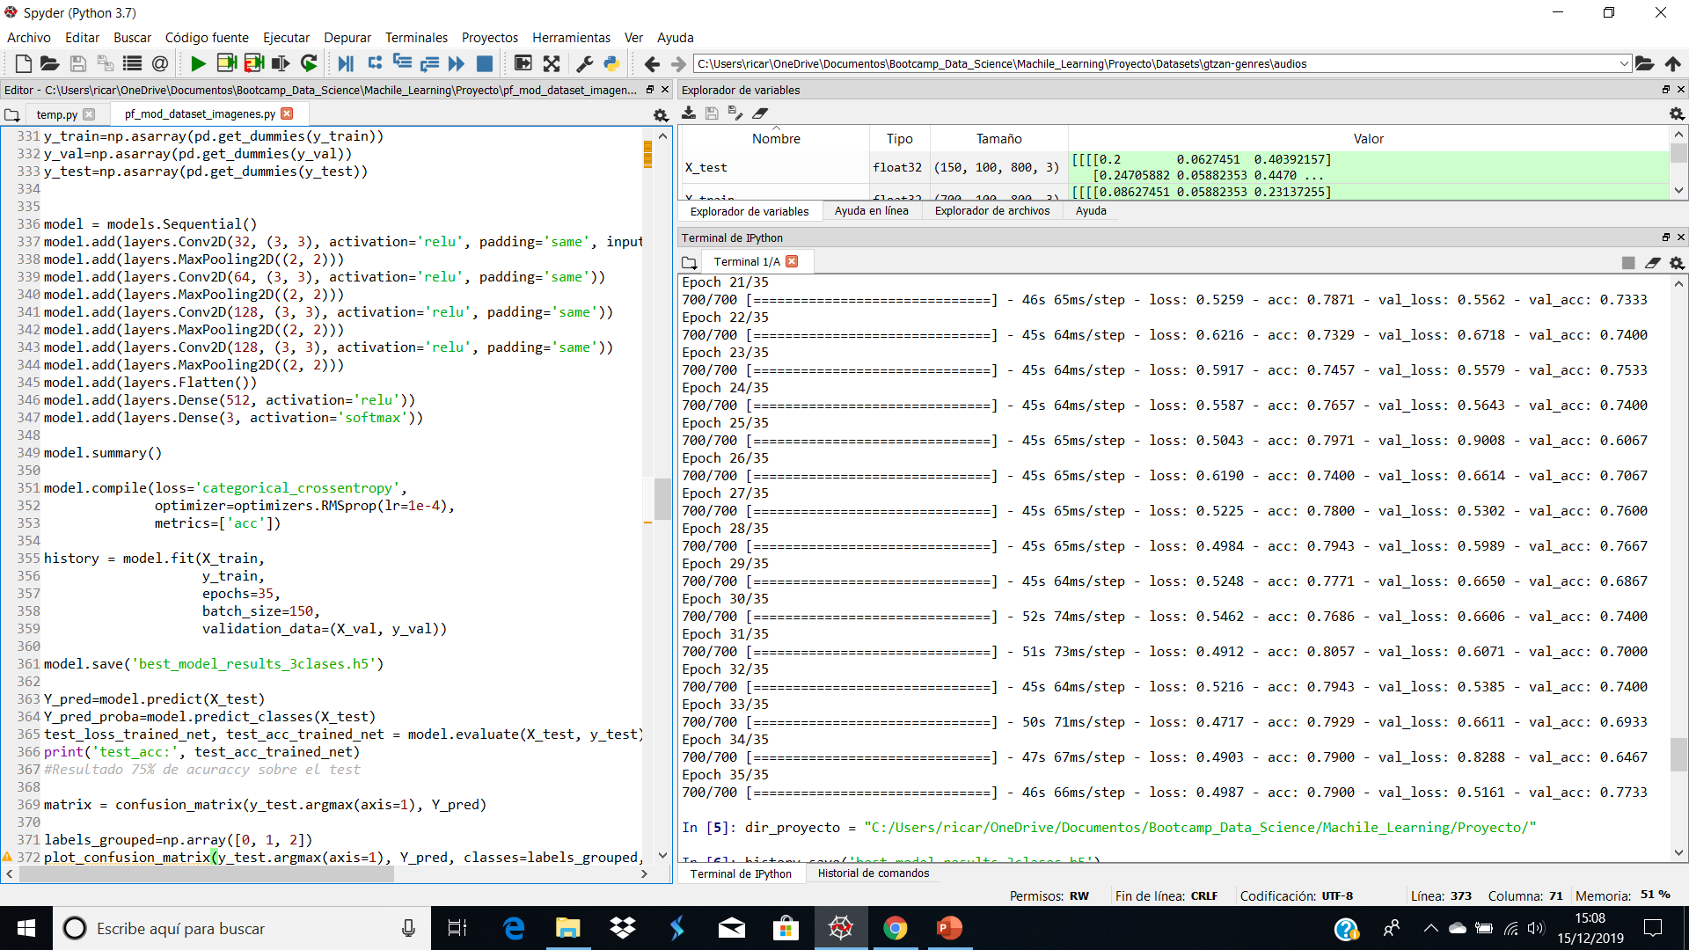

Slide 22
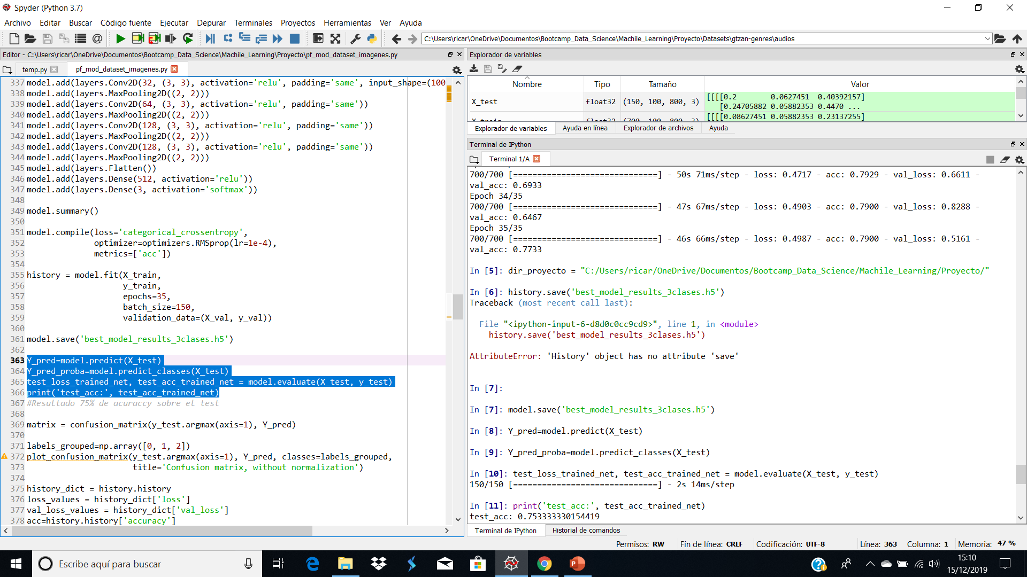
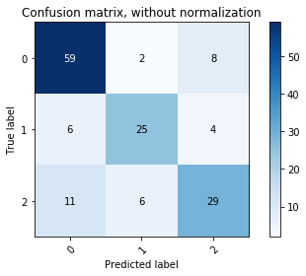
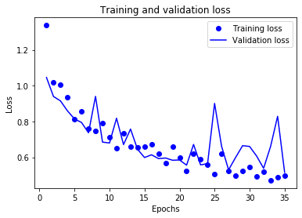
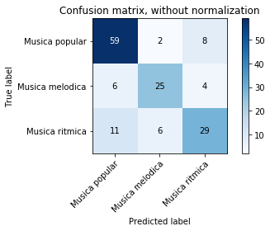
[[59 2 8]
[ 6 25 4]
[11 6 29]]

Slide 23
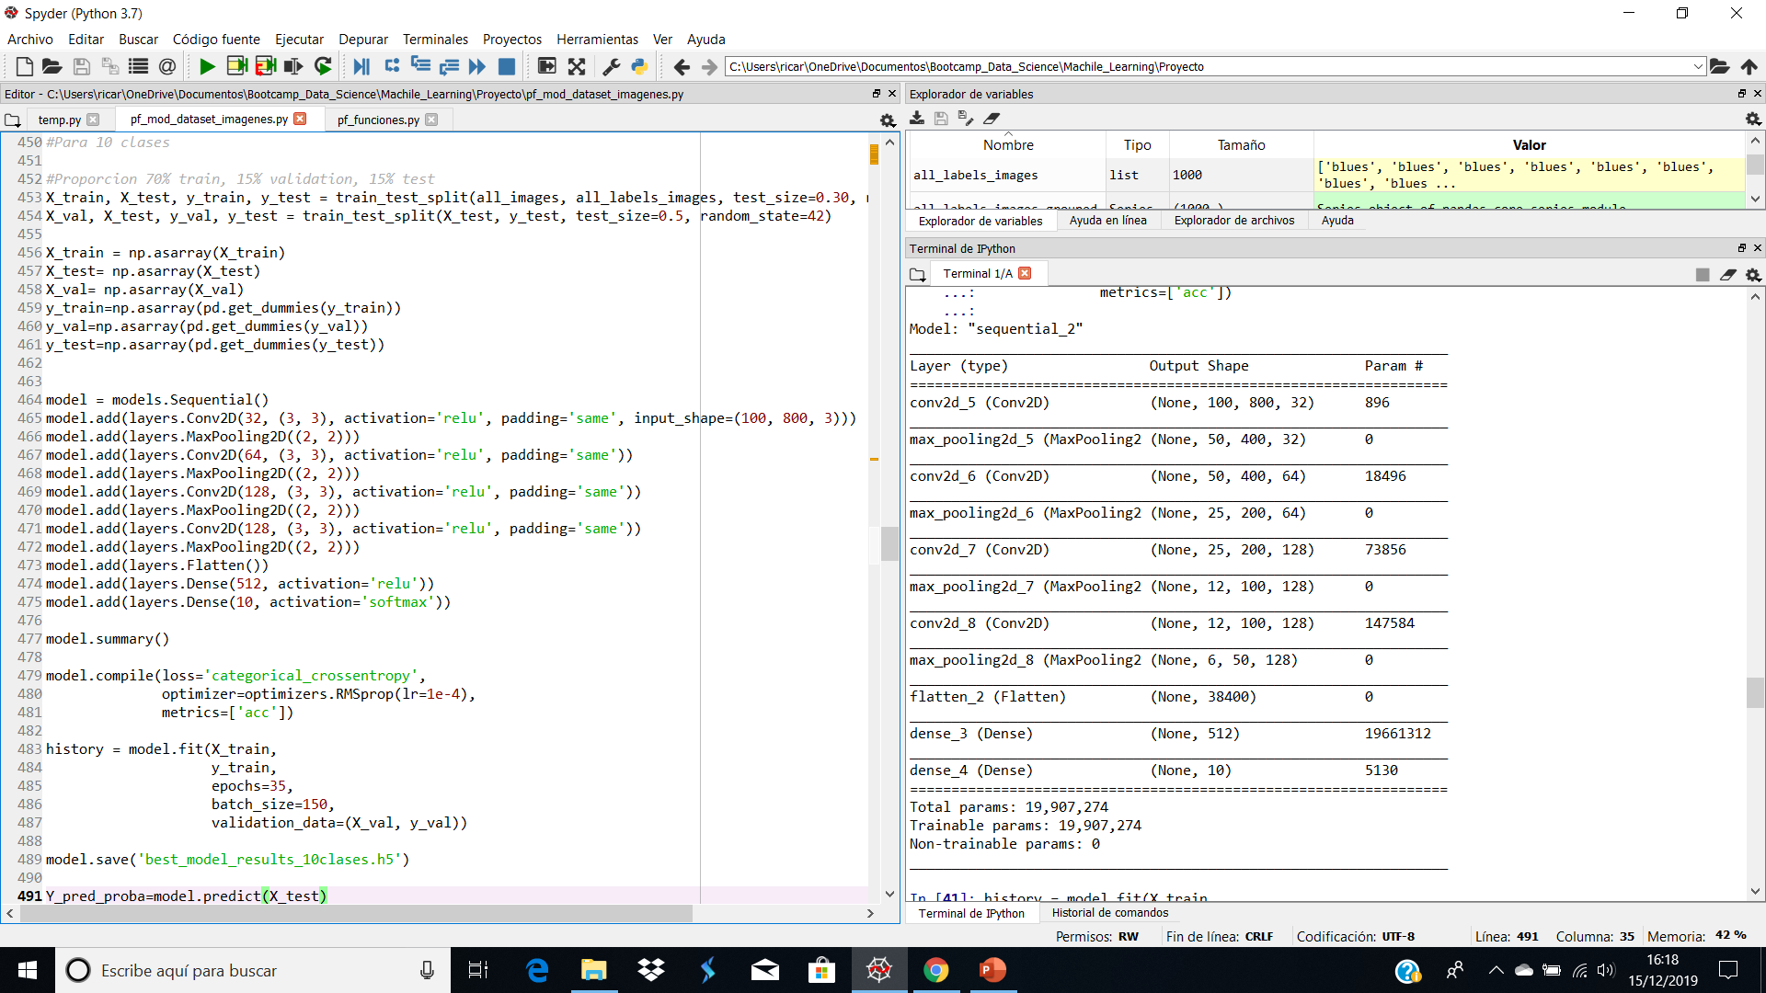

Slide 24
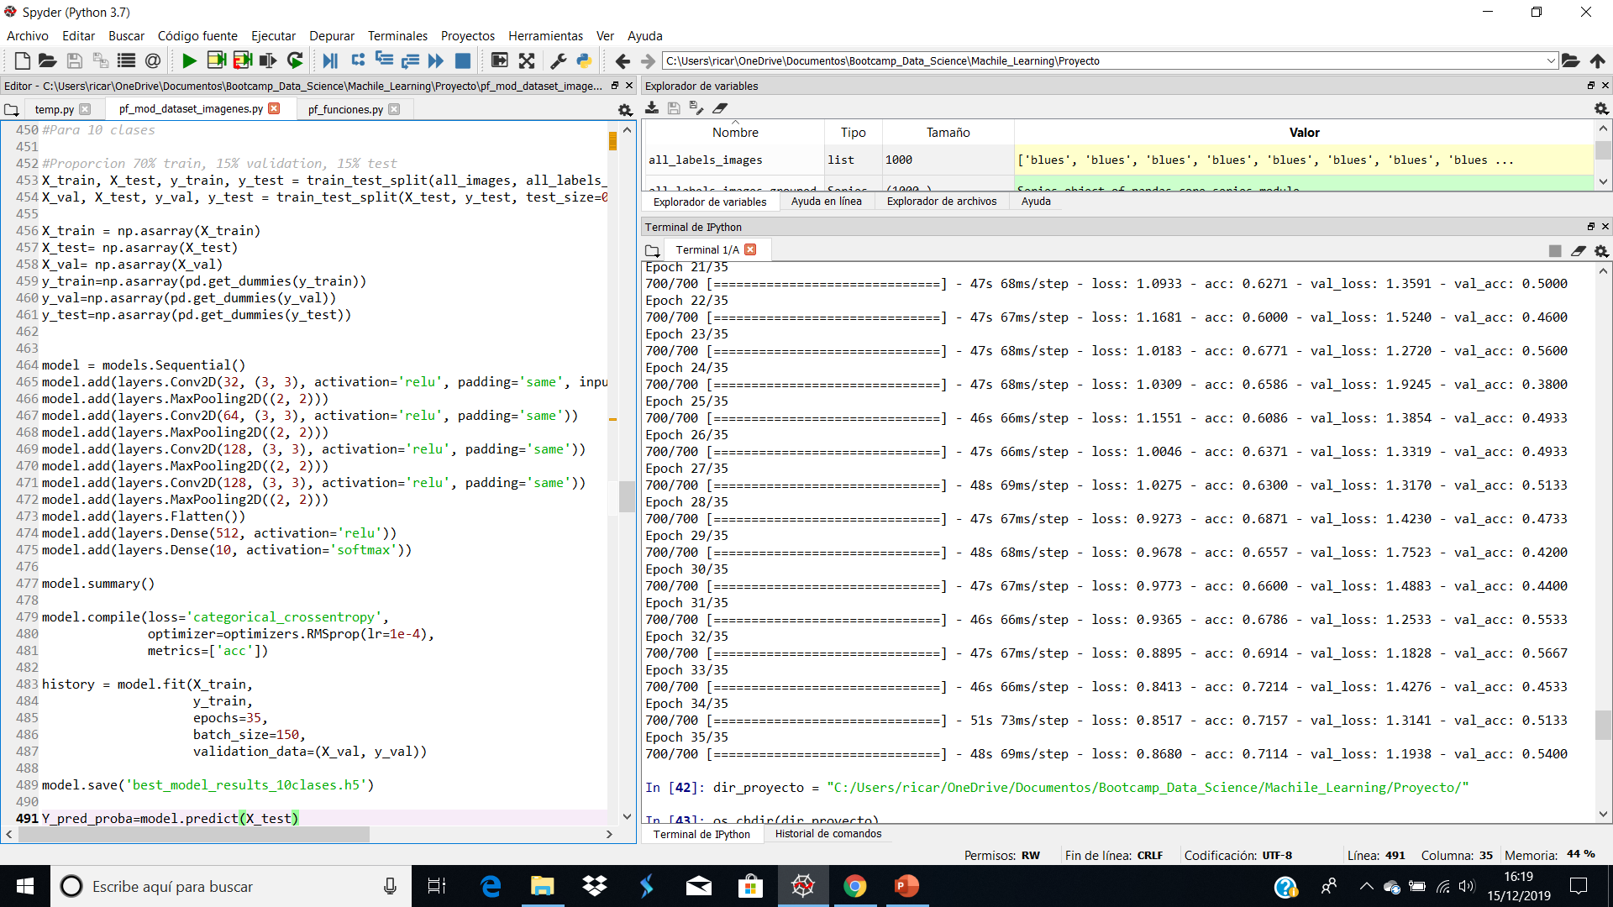

Slide 25
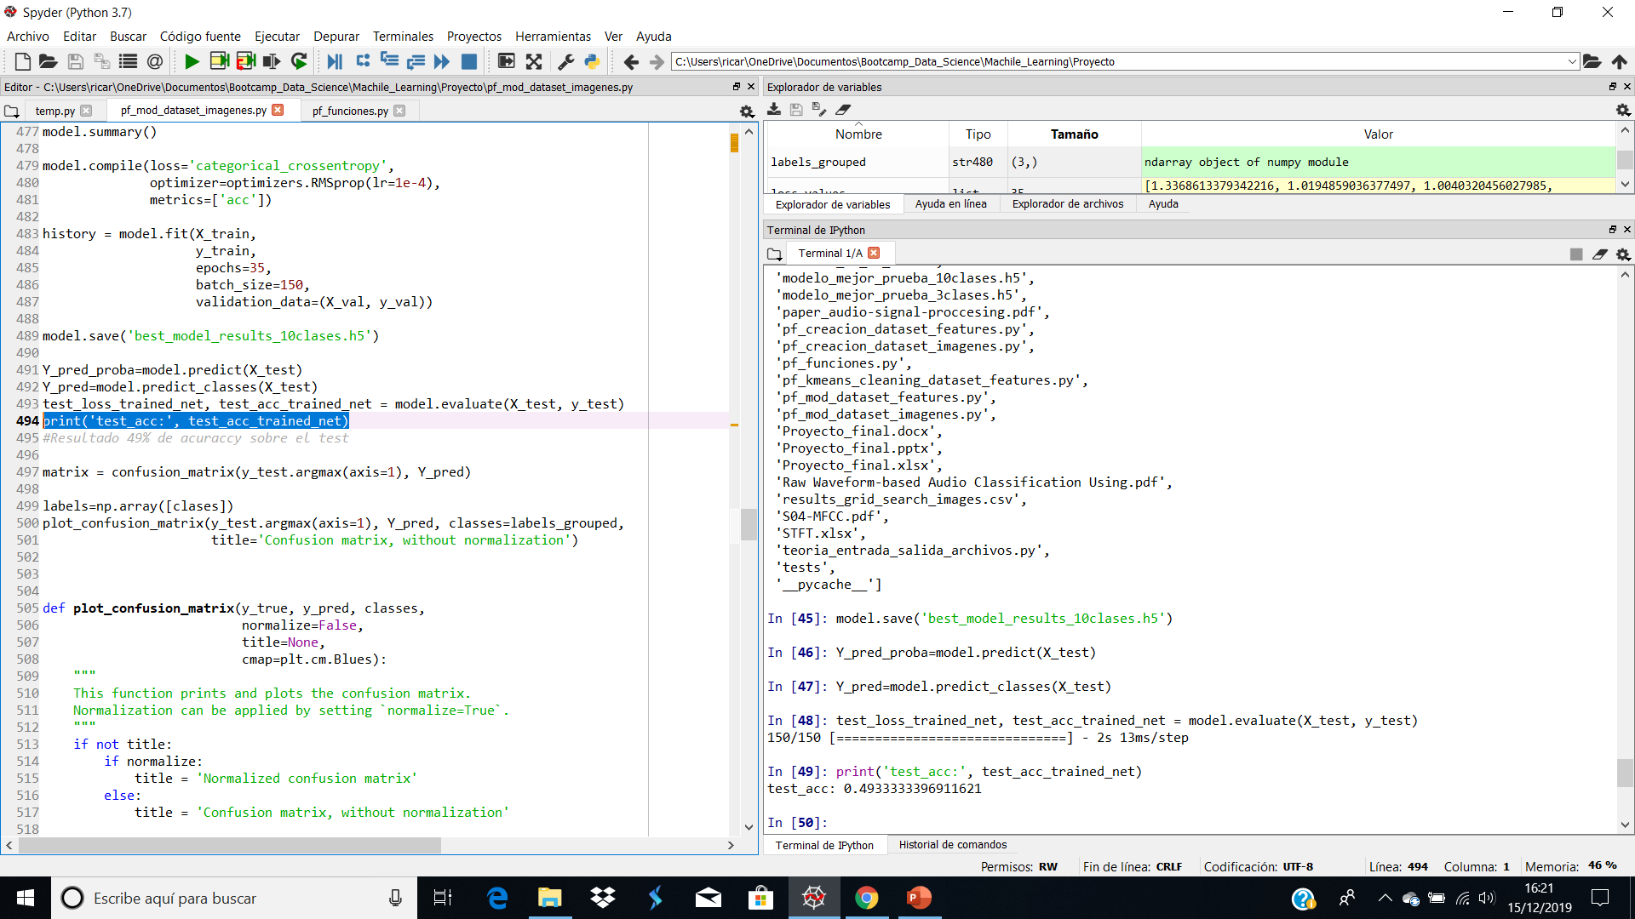


[[ 5 1 0 7 0 0 0 0 3 0]
[ 0 11 0 1 0 0 0 0 0 0]
[ 2 1 3 7 2 2 1 0 1 5]
[ 0 0 0 12 1 0 1 2 1 0]
[ 0 0 0 0 5 0 0 1 3 0]
[ 2 5 0 0 1 9 0 0 0 0]
[ 0 0 0 0 1 0 13 0 0 0]
[ 0 0 0 0 0 1 0 7 0 0]
[ 1 1 0 4 2 0 0 2 8 0]
[ 1 0 0 7 1 0 3 1 1 1]]

Slide 26
RESULTADOS MODELOS FEATURES

Slide 27


Slide 28


Slide 29



[[12 0 0 0 0 0 0 0 1 3]
[ 0 12 0 0 0 0 0 0 0 0]
[ 3 0 17 0 1 1 0 0 0 2]
[ 1 0 0 10 1 1 1 2 1 0]
[ 0 0 0 0 8 0 0 0 1 0]
[ 0 1 1 0 0 14 0 0 0 1]
[ 0 0 0 0 1 0 13 0 0 0]
[ 0 0 1 0 1 0 0 6 0 0]
[ 1 0 0 3 2 1 0 1 9 1]
[ 4 0 1 1 0 1 3 2 0 3]]

Slide 30


Slide 31


Slide 32



[[60 5 4]
[ 4 27 4]
[ 9 7 30]]

